Slide 1
Slides from the
2008 season of excavations
at Tell Mozan
ancient Urkesh
Giorgio Buccellati
Marilyn Kelly-Buccellati
Federico Buccellati
November 2008

Slide 2
1 Background
2 Excavations in the Plaza (J5, J1, J6, J7)
J5 The Mittani re-organization
J1The fourth millennium
J1 and J2 An architectural “logogram”?
J6 The eastern frame of the staircase
J7 The eastern edge of the Plaza
3 The western service quarter (A20)
4 The Objects
5 Site presentation
The itinerary as a narrative
The “footnotes”
The synthetic panels
The eco-archaeological Park
The visitors
6 The visit by the First Lady

Slide 3
1
Background
Some introductory slides show the general geographical location of the site, and the site plan with the lcoation of the excavation units.

Slide 4
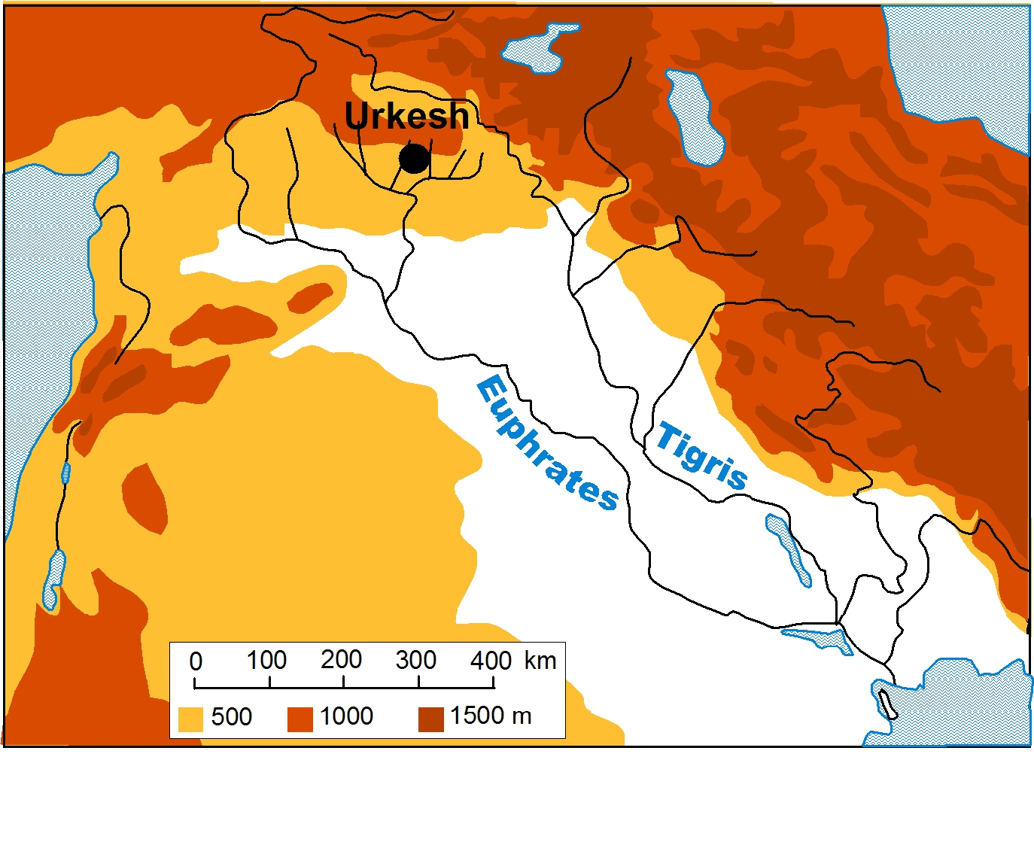
Copyright 2008 - IIMAS

Slide 5
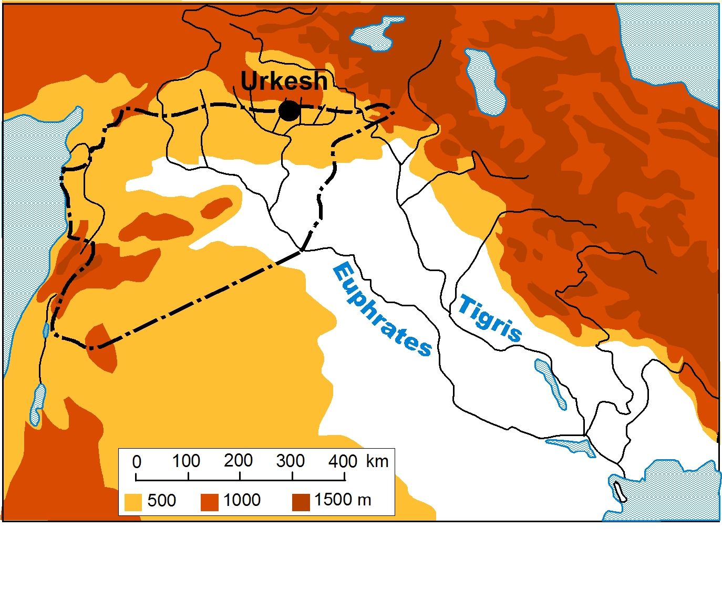
TURKEY
SYRIA
IRAQ
Copyright 2008 - IIMAS

Slide 6
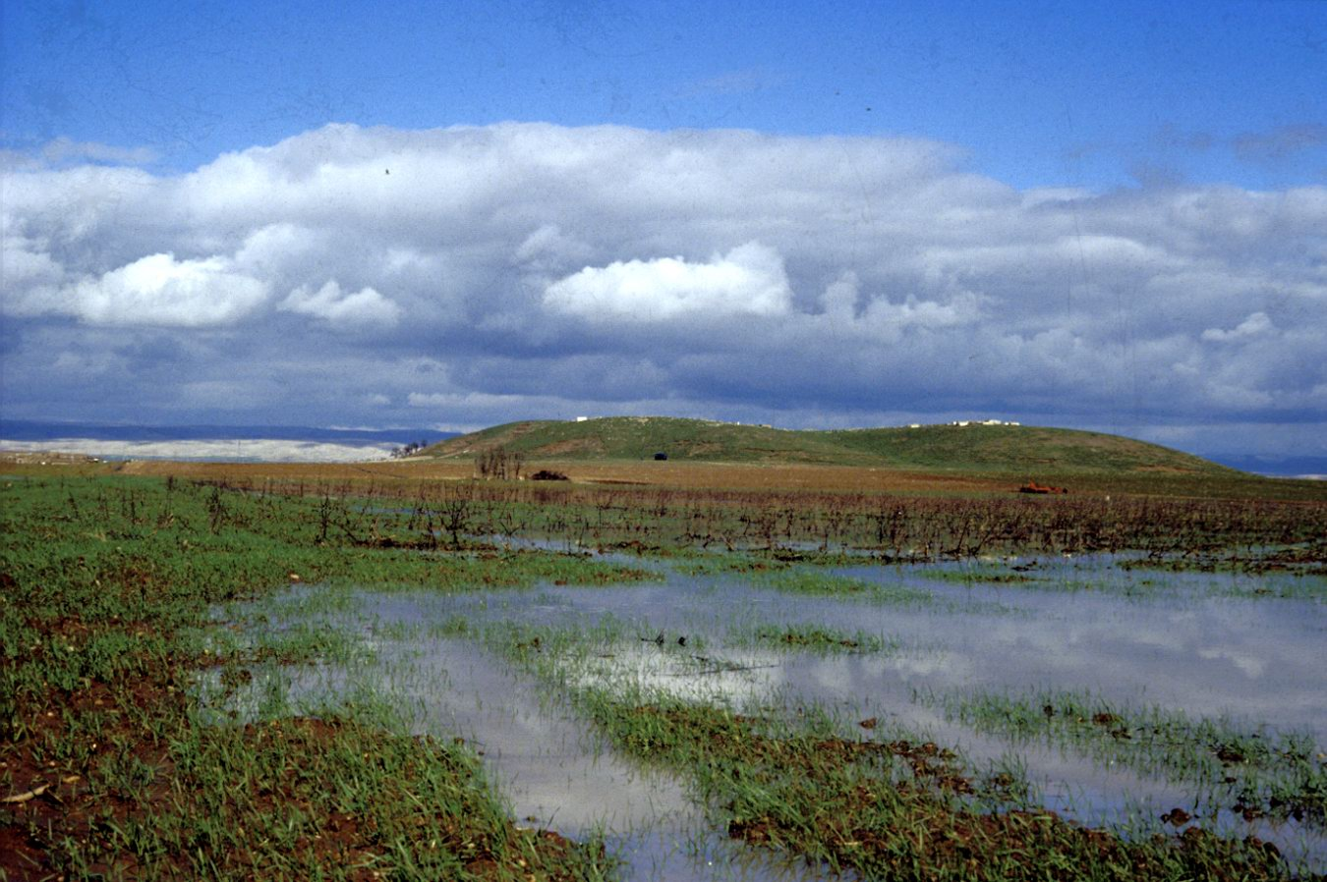
winter rains
Copyright 2008 - IIMAS

Slide 7
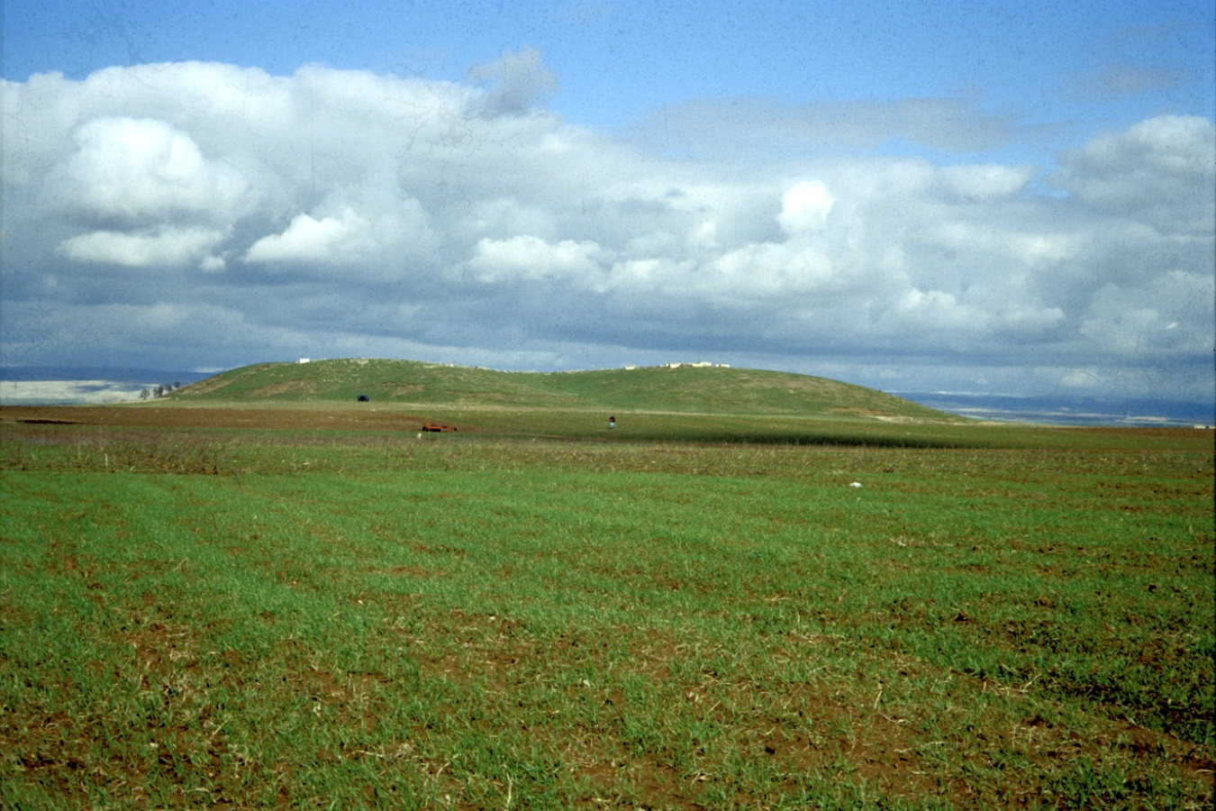
Copyright 2008 - IIMAS

Slide 8
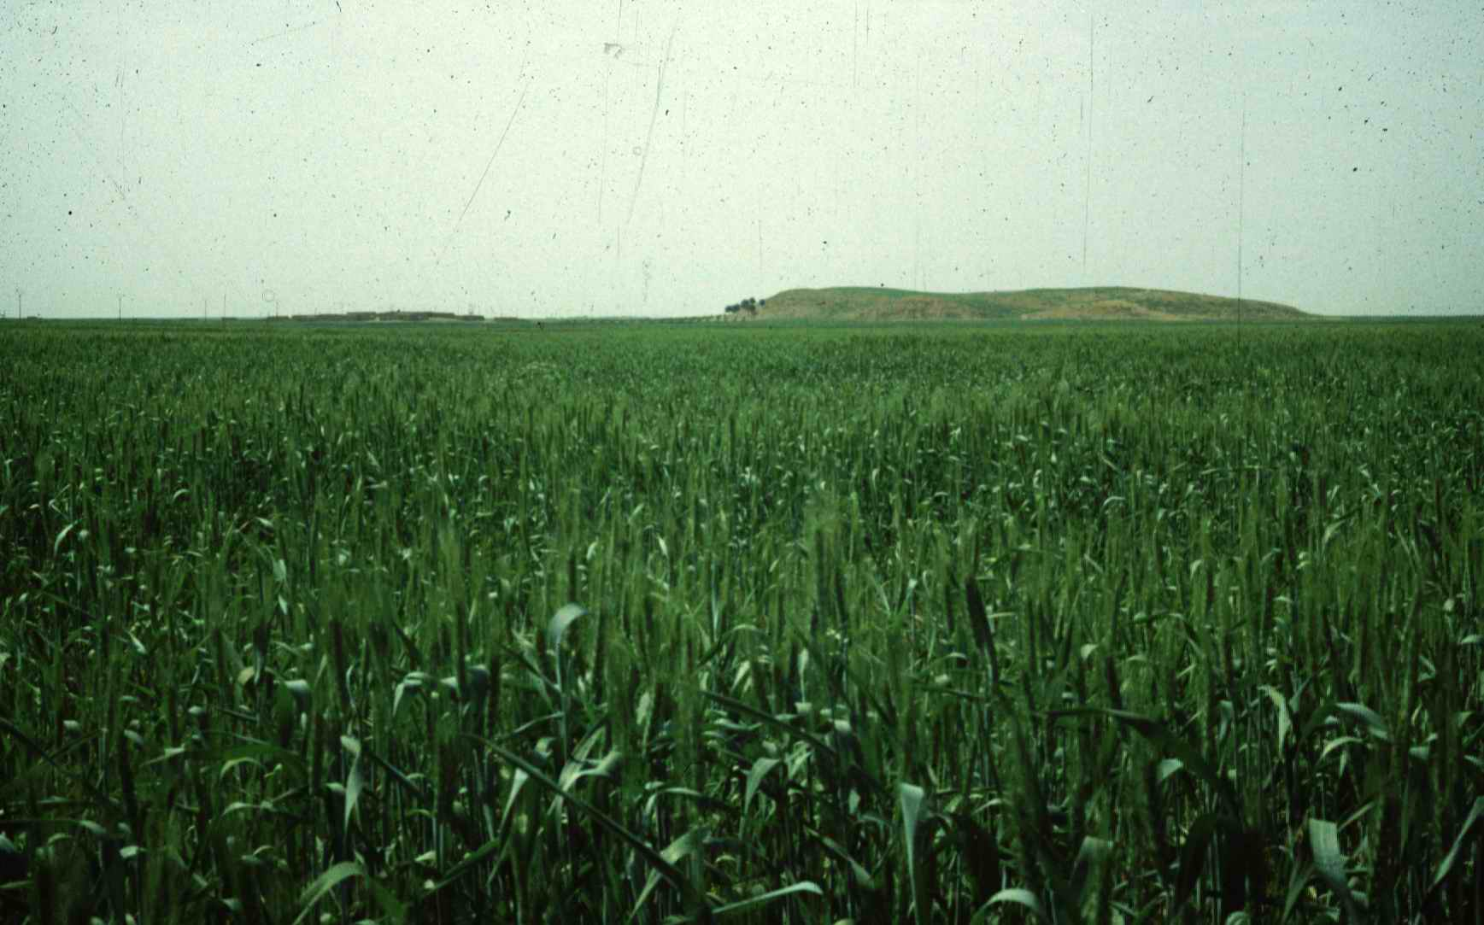
Copyright 2008 - IIMAS

Slide 9
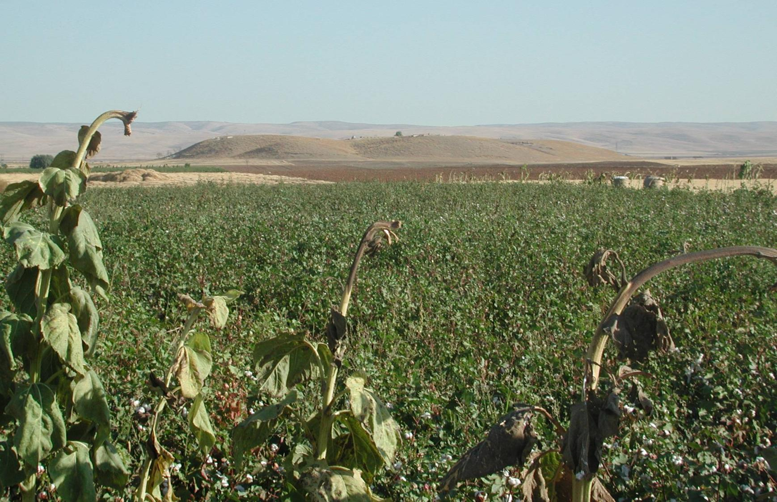
Copyright 2008 - IIMAS

Slide 10
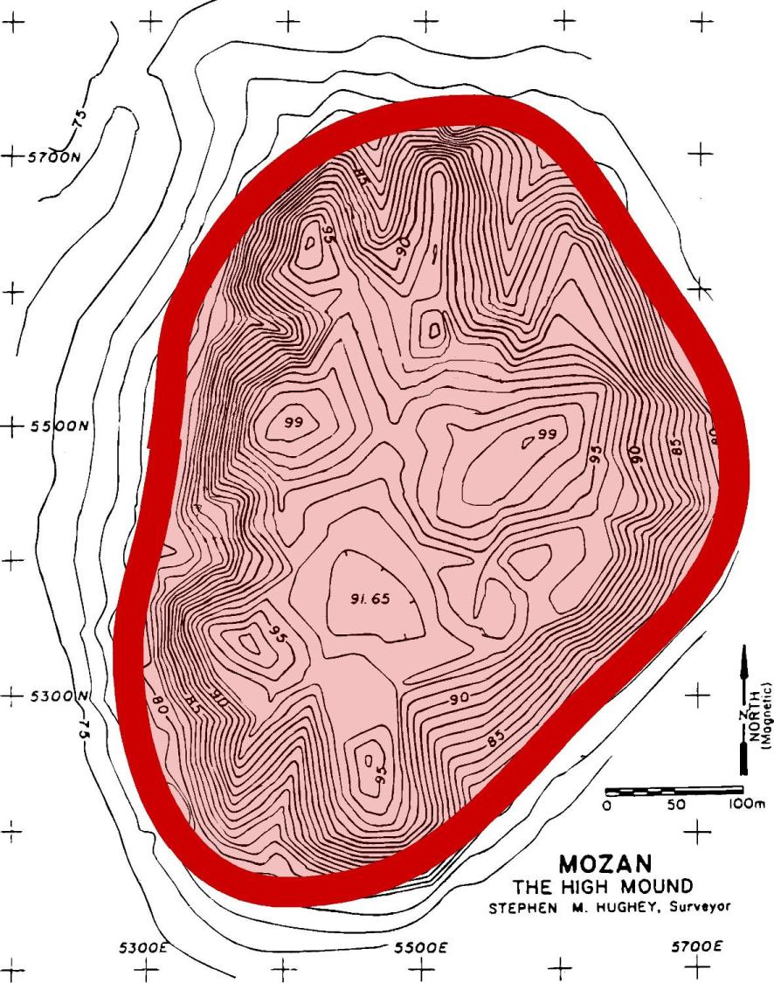
Excavation
Units
in 2008
Temple
and
Temple
Terrace
Royal
Palace
of Tupkish
A20
J5
J1
J6
J7
Copyright 2008 - IIMAS

Slide 11
2
Excavations in the Plaza
(J5, J1, J6, J7)
Four excavation units were opened in the Plaza.
The first two slides show their location in relationship to the Temple Terrace.

Slide 12
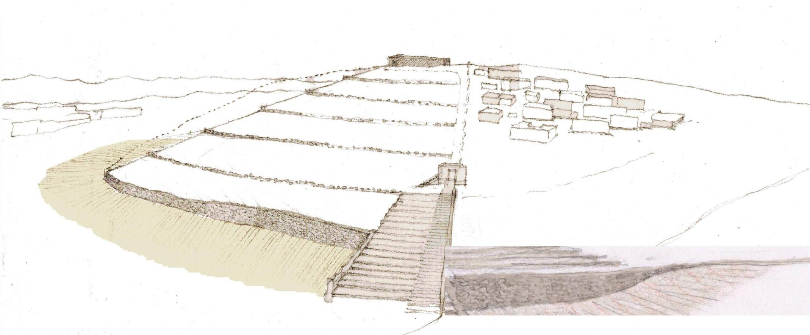
Temple
J5
glacis
J1
revetment wall
scalinata
escarpment
J6
plaza
J7
Location of 2008 excavation units in the Temple area
Copyright 2008 - IIMAS

Slide 13
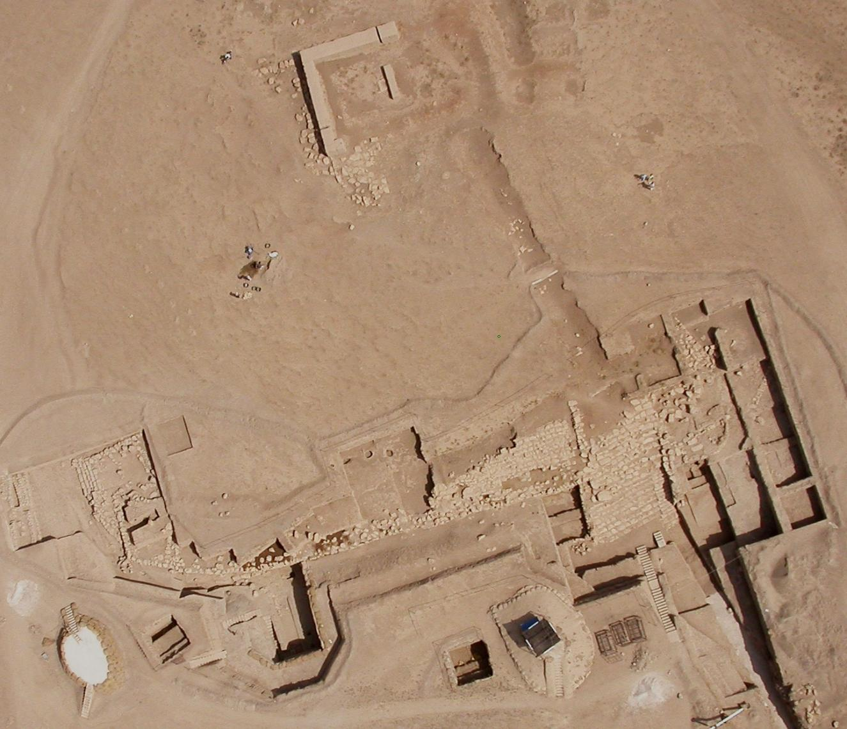
Temple BA
2008
Excavation
Units
J5
J6
Copyright 2008 - IIMAS
J1
J7

Slide 14
J5
The Mittani re-organization
The great southern staircase now more fully exposed in J6 was abandoned in the middle of the Mittani period and a new, much smaller staircase was built in the west.
This secondary staircase is probably connected with the structures excavated this year in A20, which we think served as the service sector of the Temple.

Slide 15
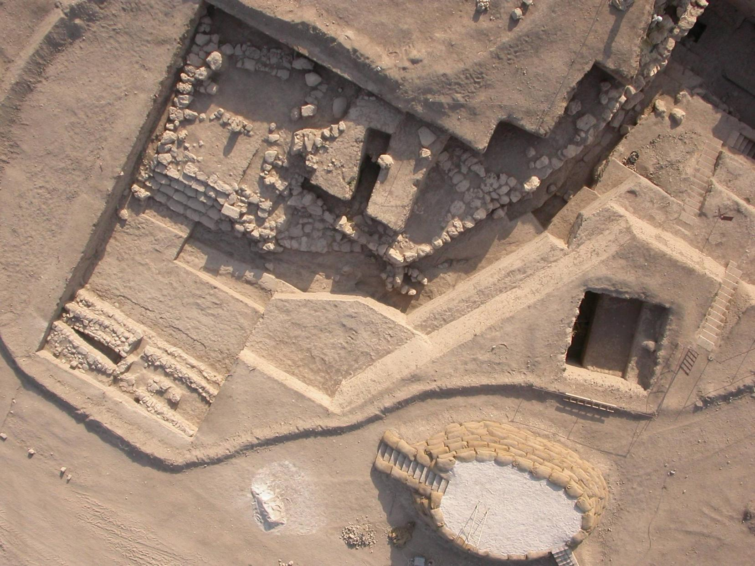
1400 B.C
J5
a secondary staircase
built in Mittani times
2600 B.C
Copyright 2008 - IIMAS

Slide 16
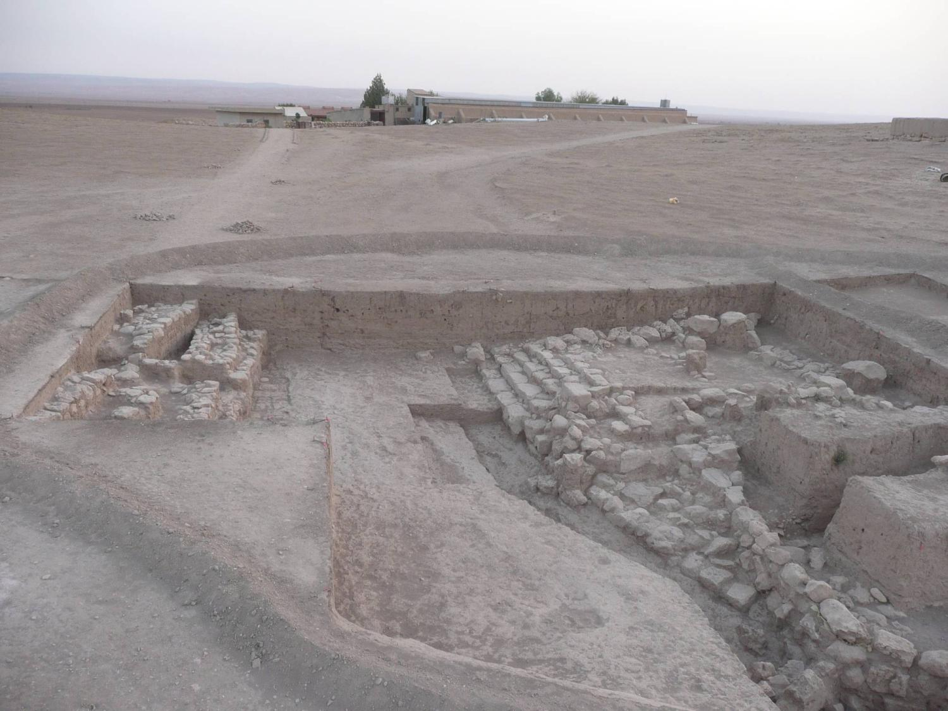
Copyright 2008 - IIMAS

Slide 17
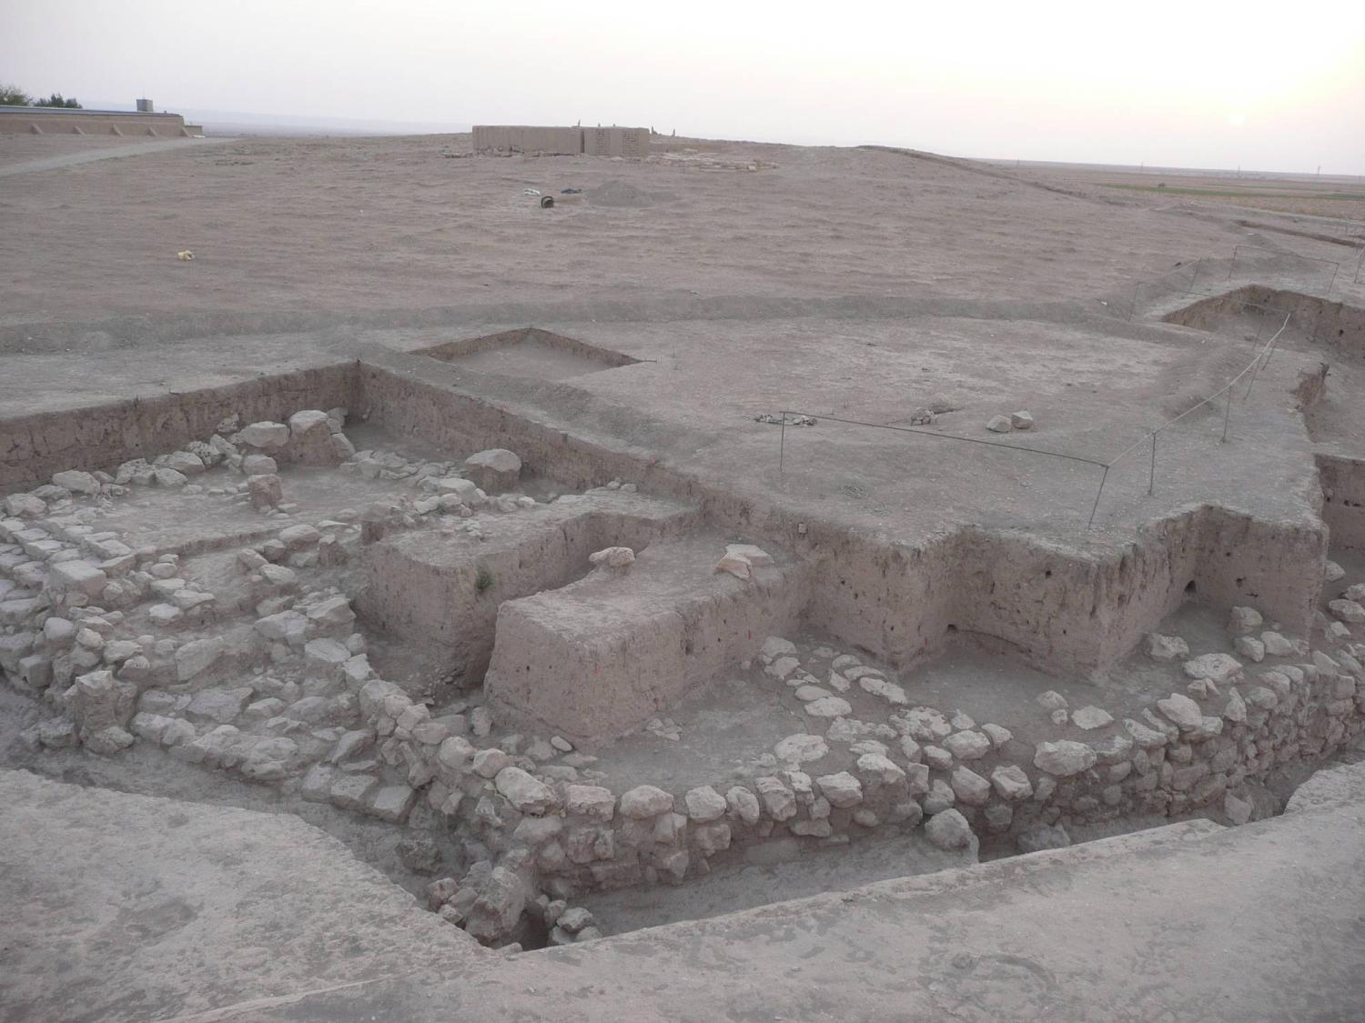
Copyright 2008 - IIMAS

Slide 18
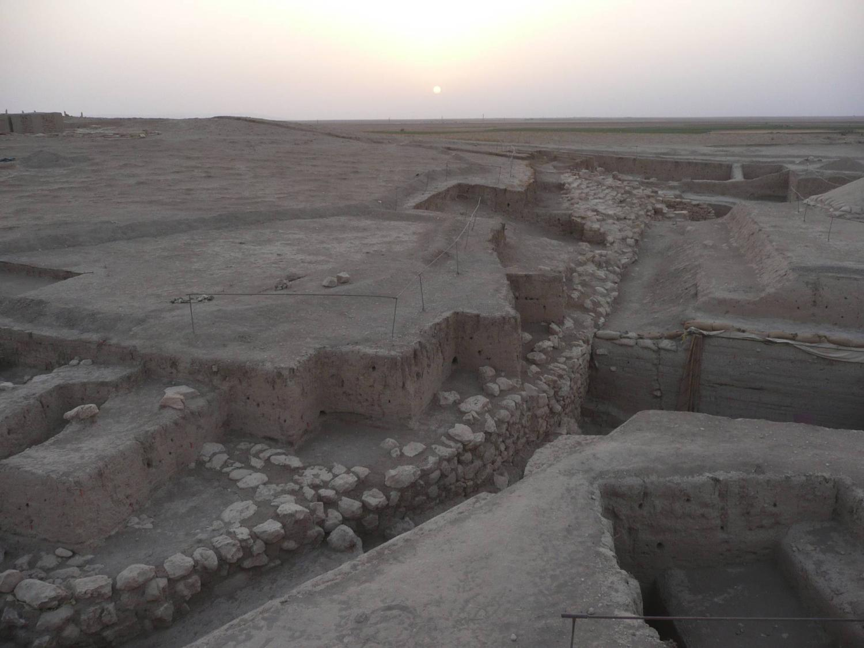
Copyright 2008 - IIMAS

Slide 19
J1
The fourth millennium
The stratigraphic situation in front of the revetment wall is most intriguing. The wall itself was built around 2500 B.C., and the escarpment that abuts it remained unencumbered by accumulations for over 1000 years.
Around the middle of the Mittani period, accumulations began to accrue, and within the span of a century (the last of Urkesh existence) they grew to a height of some three meters, completely covering the revetment wall.
In front of the wall, a small sounding has revealed a stone structure of the fourth millennium, which is presumably the antecedent of the revetment wall. This is very significant because it means that the Temple Terrace was most likely in existence in Late Chalcolithic times – thus bringing back by a millennium the evidence of Hurrian presence in Syria.

Slide 20
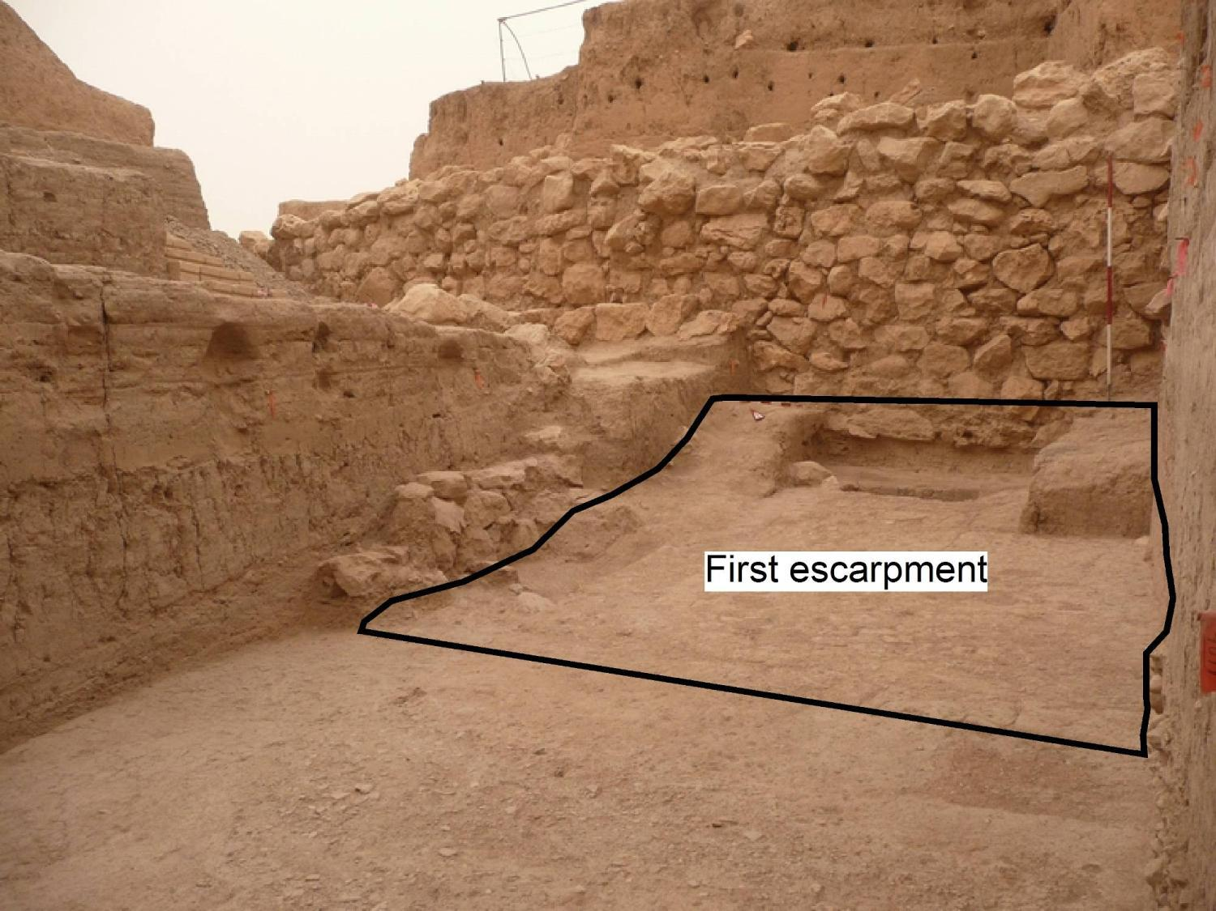
2500 B.C.
Copyright 2008 - IIMAS

Slide 21
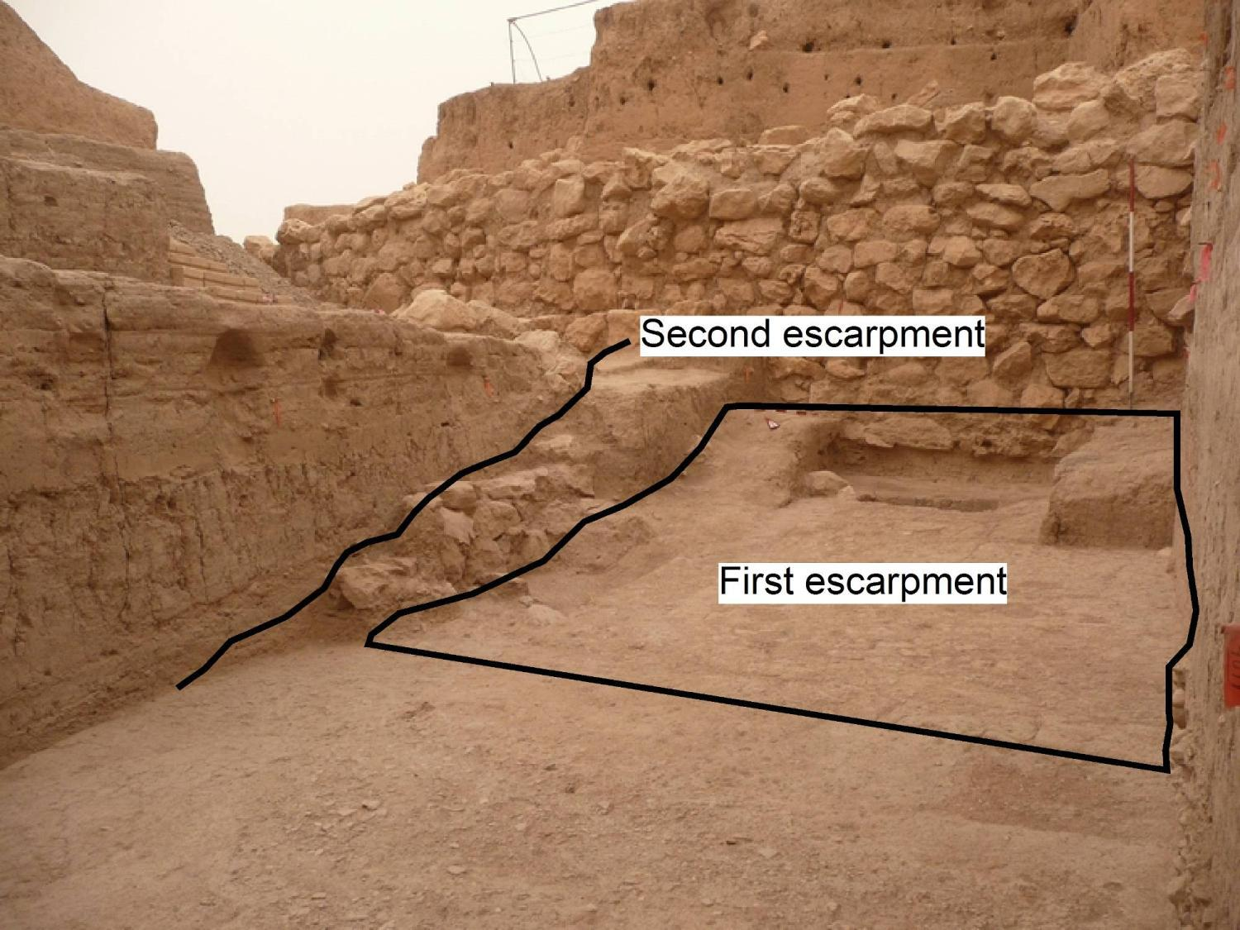
2400 B.C.
2500 B.C.

Slide 22
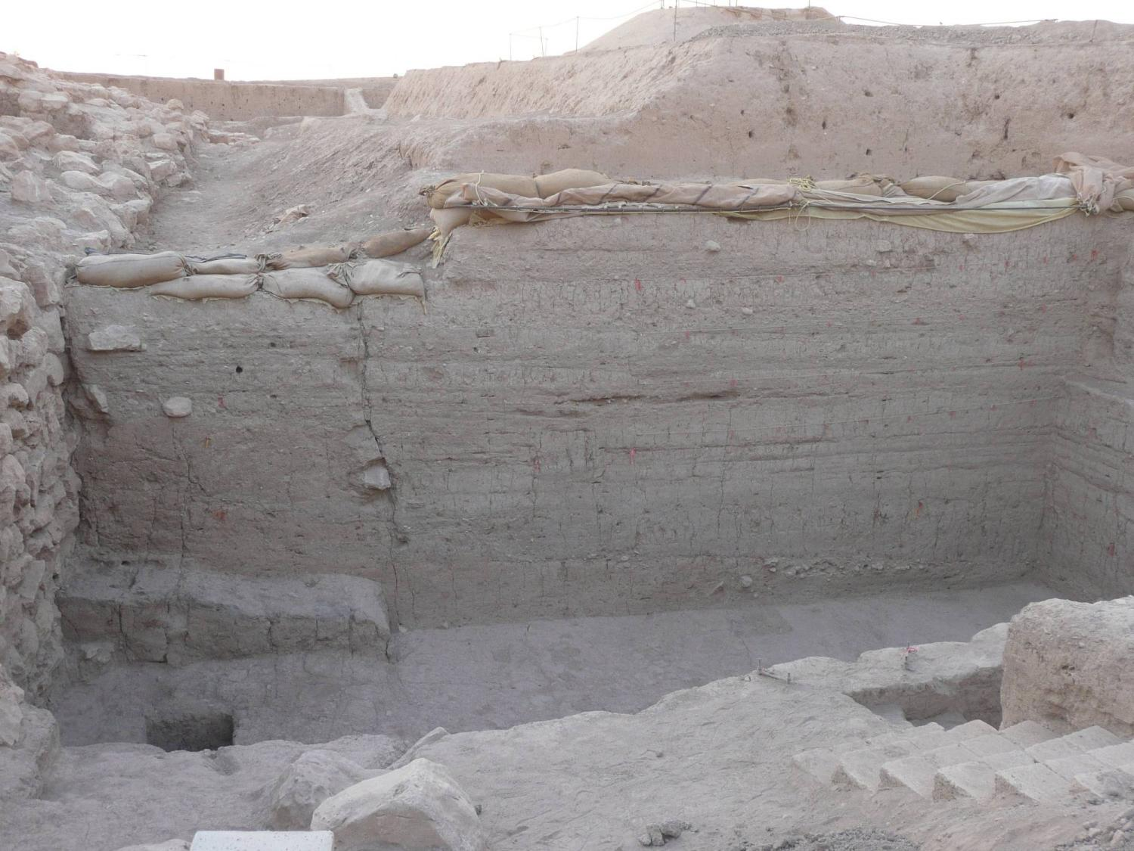
Mittani accumulations
1400-1300 B.C.
Second escarpment
2400 B.C.
First escarpment
2500 B.C.

Slide 23
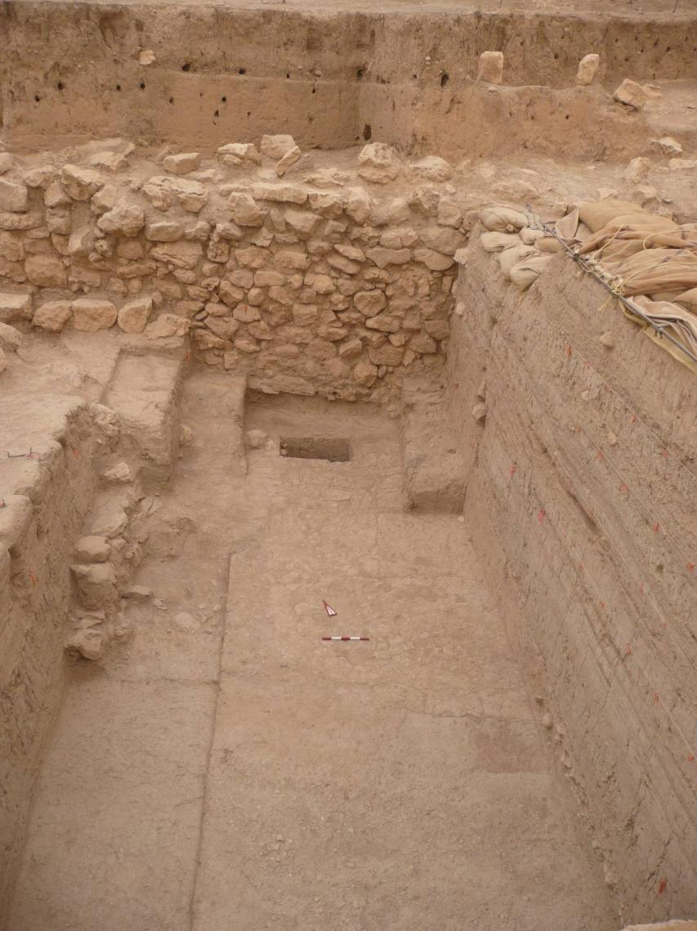
Sounding
with stone structure
of the
fourth millennium
Copyright 2008 - IIMAS

Slide 24
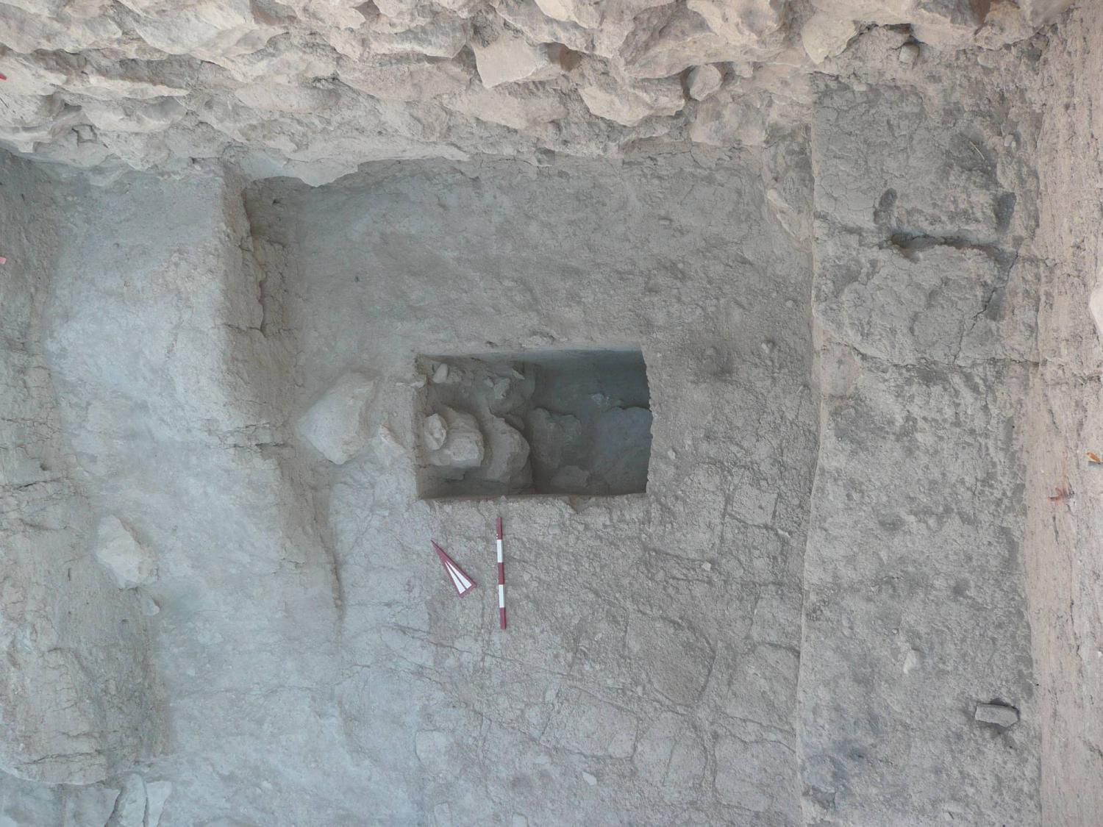
Wall – 2600 B.C.
Wall - 3500 B.C.
Copyright 2008 - IIMAS

Slide 25
J1 and J2
An architectural “logogram”?
The revetment wall of the third millennium exhibits an interesting triangular pattern.
We interpret it as an architectural “logogram” in the sense that it suggests a reference to the mountains always visible on the Urkesh horizon.
It is the kind of iconographic motif that occurs regularly on contemporary seals.

Slide 26
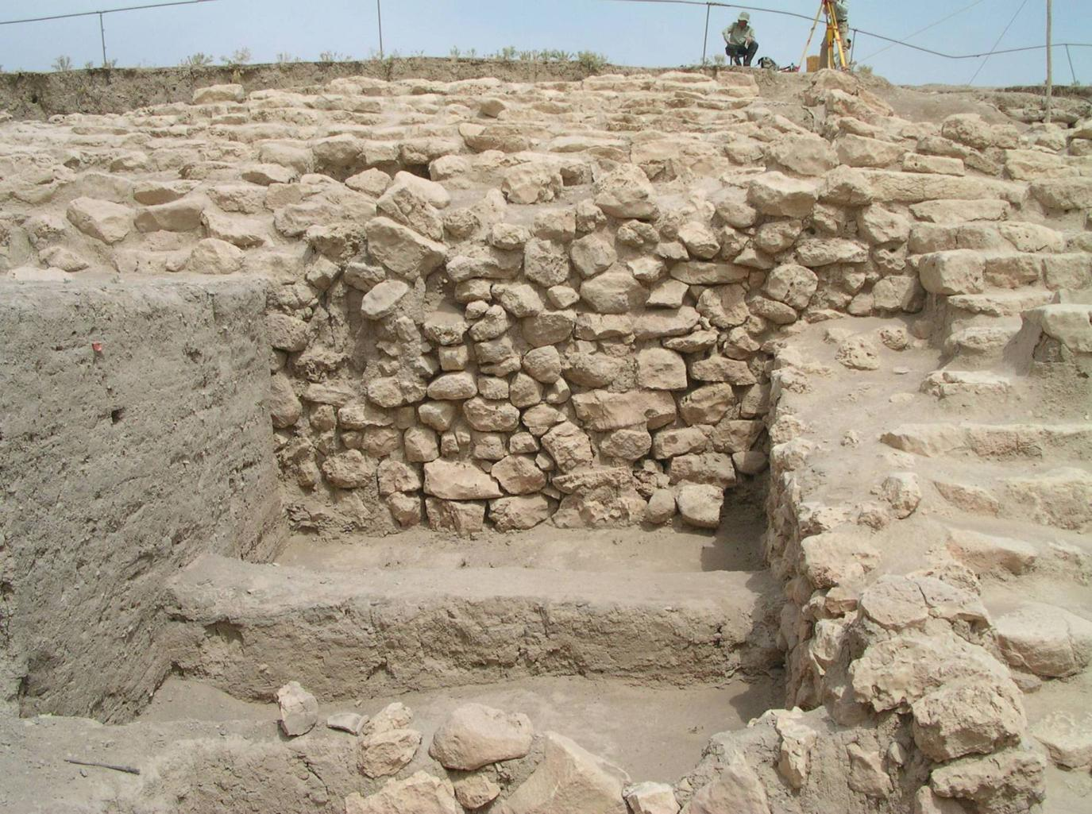
J2
Copyright 2008 - IIMAS
Notes:
View J1-J2 from panorama

Slide 27
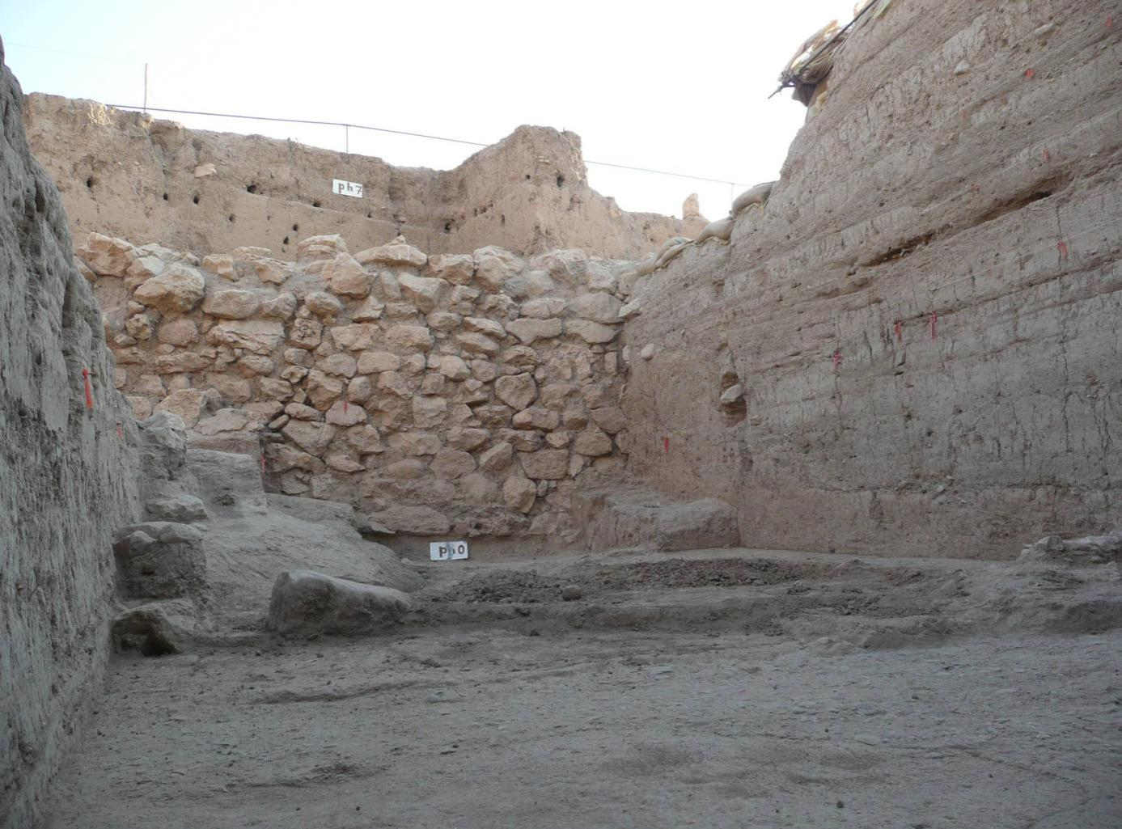
J1
Copyright 2008 - IIMAS

Slide 28
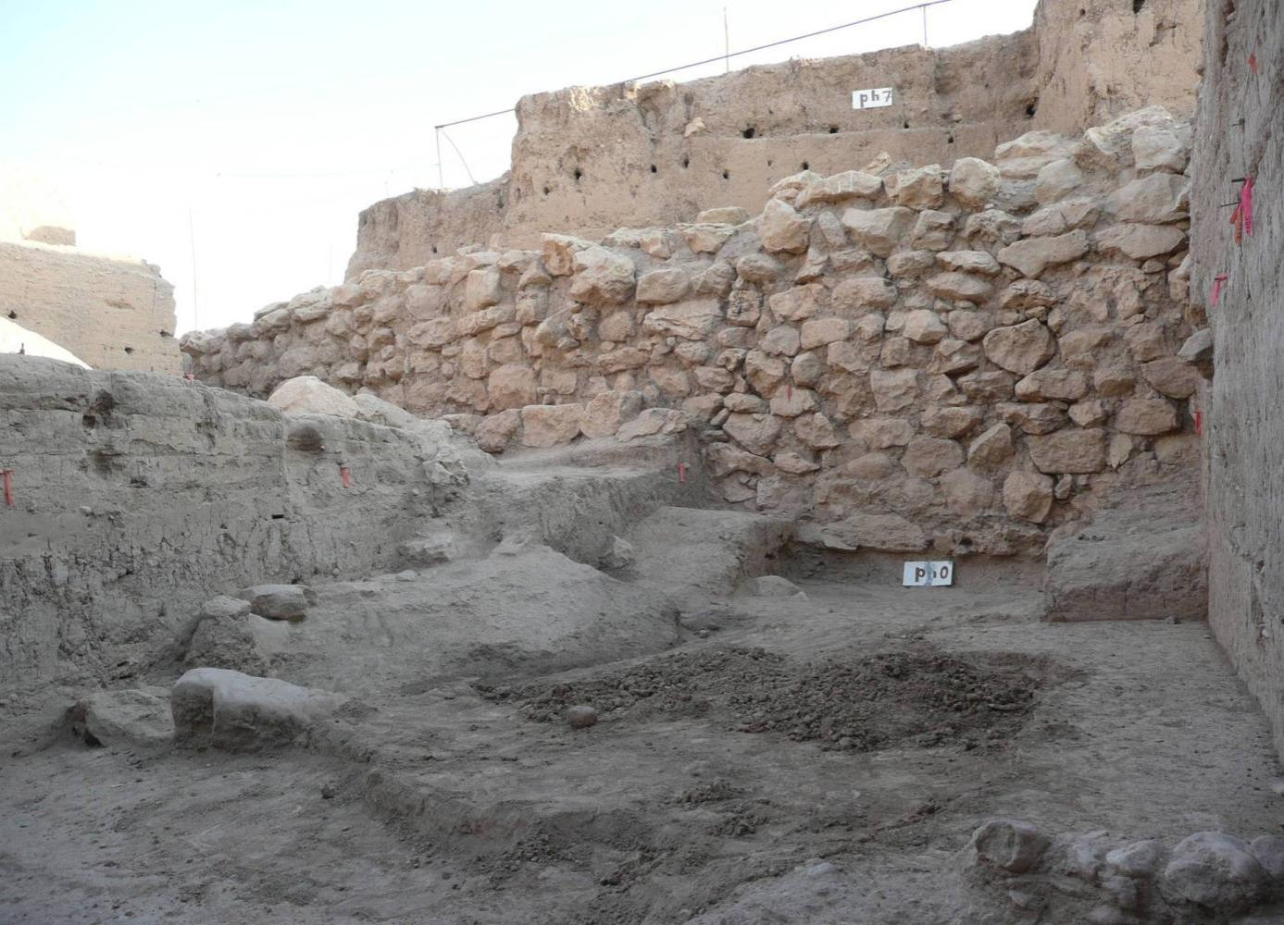
J1
Copyright 2008 - IIMAS

Slide 29
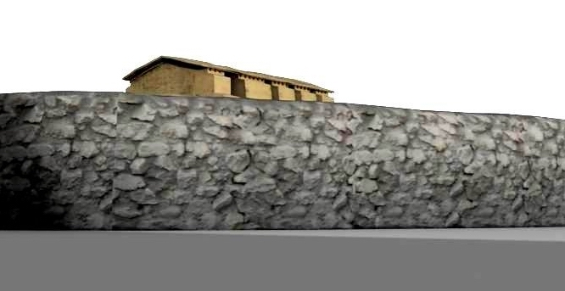
Copyright 2008 - IIMAS
Notes:
Main objection: if intentional, why not clearer?

Slide 30
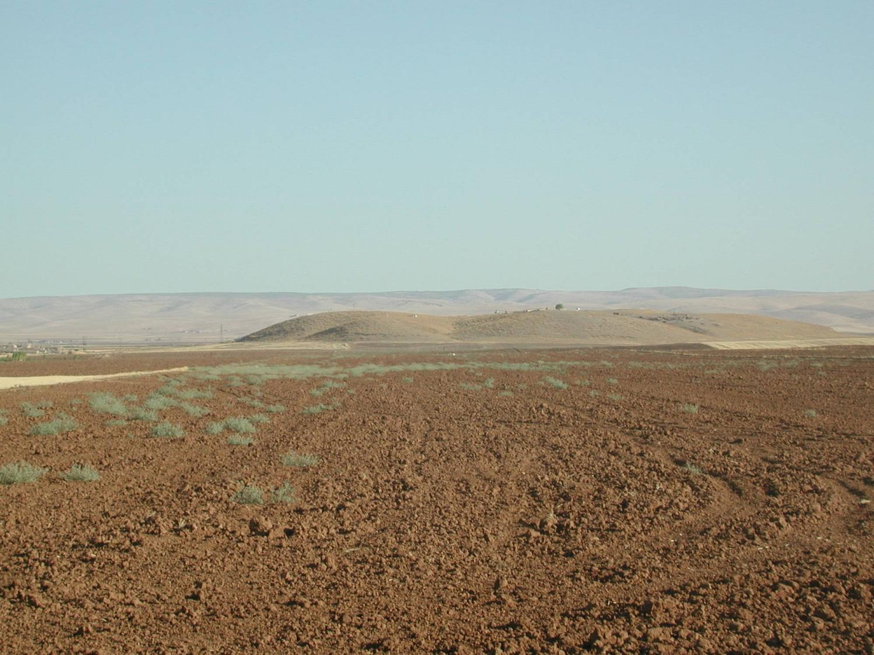
Copyright 2008 - IIMAS
Notes:
Next question why?
Perceptual impact of mountains

Slide 31
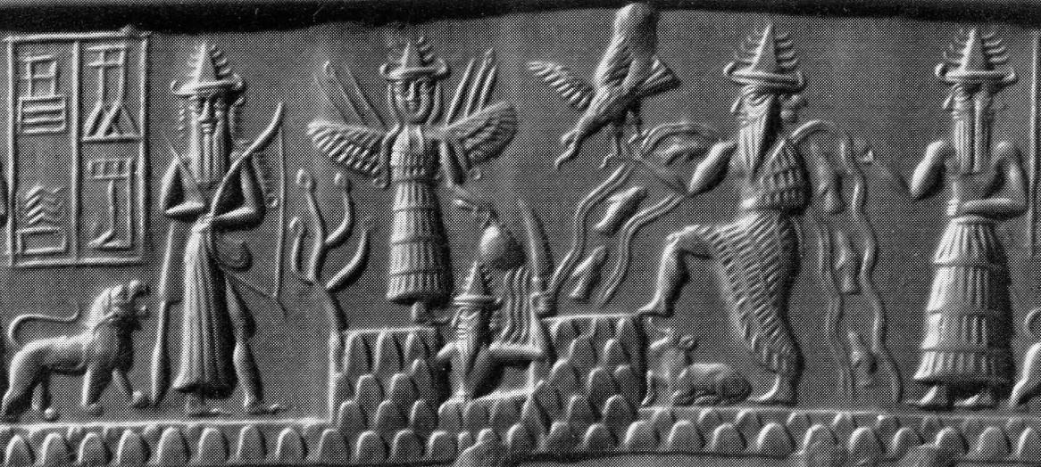
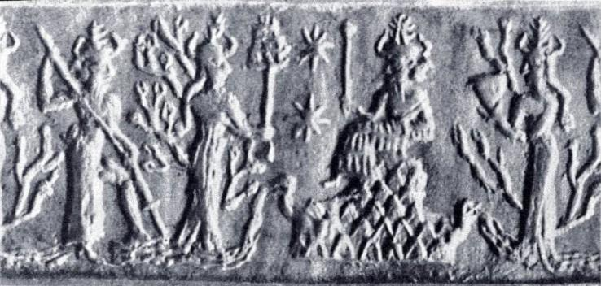
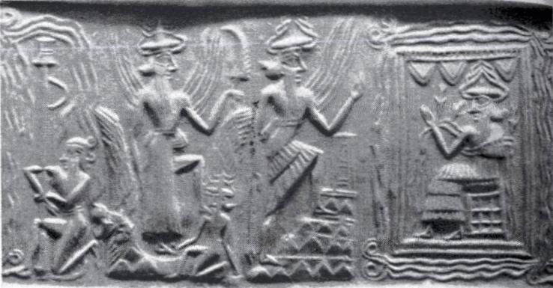
Copyright 2008 - IIMAS
Notes:
Orthmann 1975 135e Adda
Orthmann 1975 136h
136d

Slide 32

il dio Kumarbi,
titolare del tempio?
Copyright 2008 - IIMAS

Slide 33
J6
The eastern frame of the staircase
Excavations in J6 explored the situation to the east of the great staircase.
It was originally thought that the wall flanking the staircase to the east would make a corner with the continuation of the revetment wall.
Instead, this side wall is free-standing, and the revetment wall presumably continues east in a line with the western wall: the side wall takes the place of the western “apron.”
An important feature are two “betili” that are placed against the southern end of the side wall: they may have served a similar function as the oblong vertical stones in the “Stelenreihe” at Tell Chuera.

Slide 34
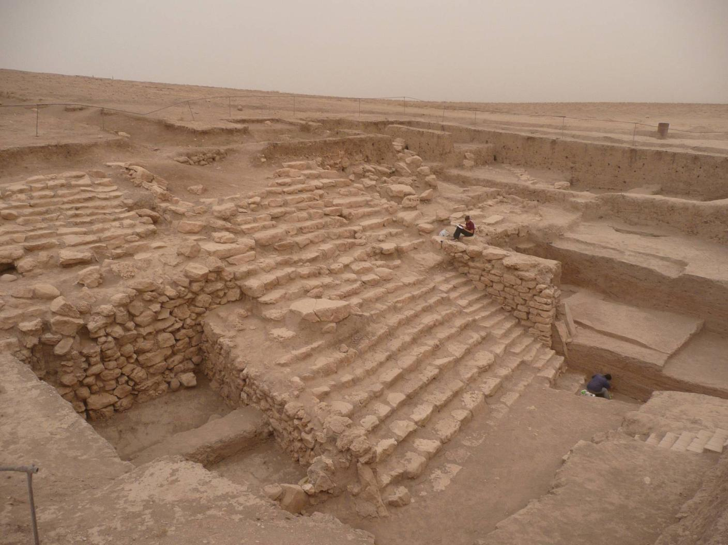
Side wall
“Betili”
Copyright 2008 - IIMAS

Slide 35
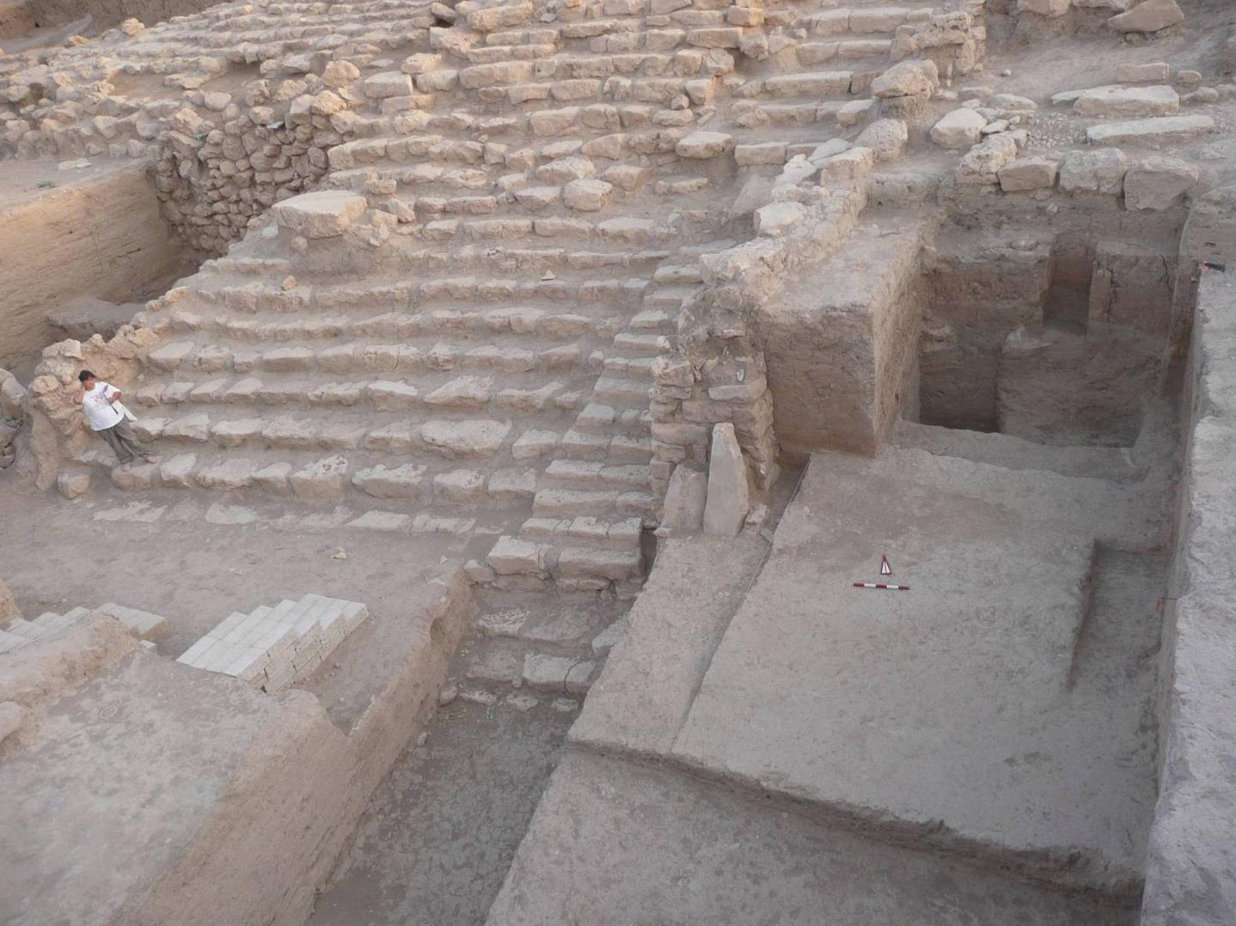
Copyright 2008 - IIMAS

Slide 36
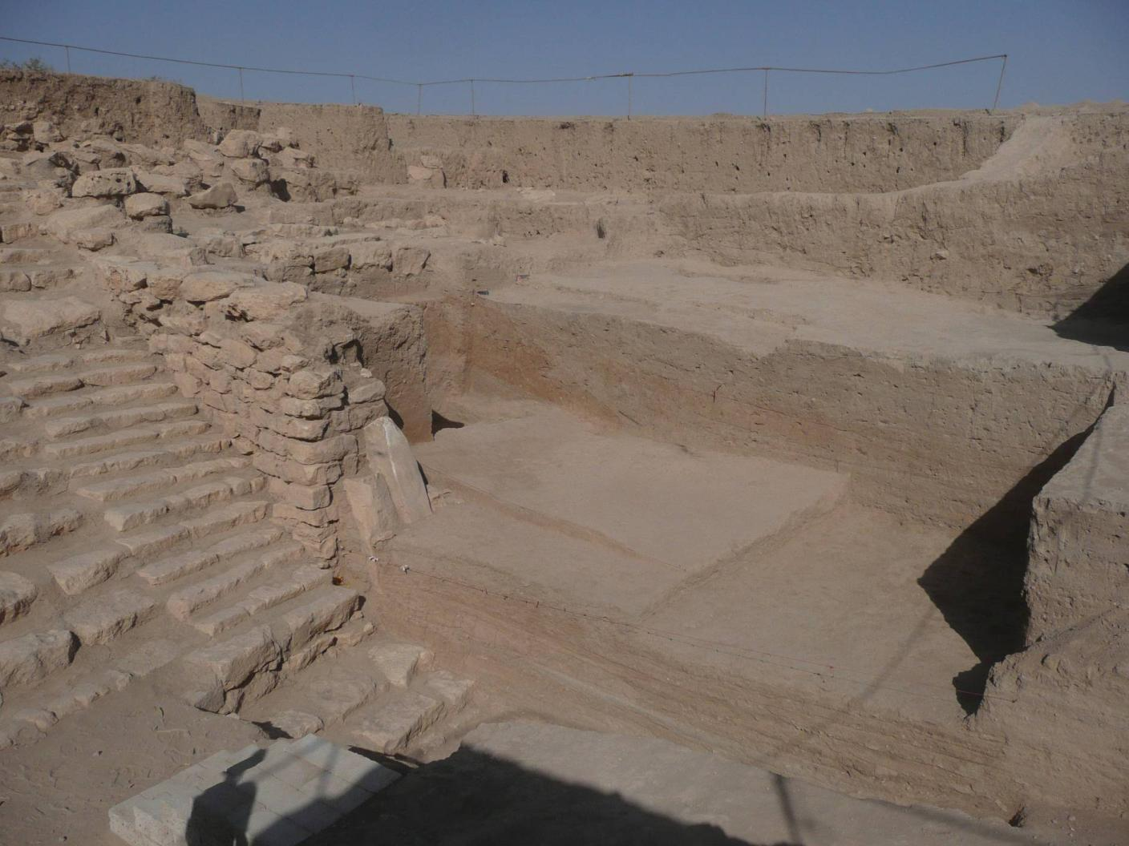
Copyright 2008 - IIMAS

Slide 37
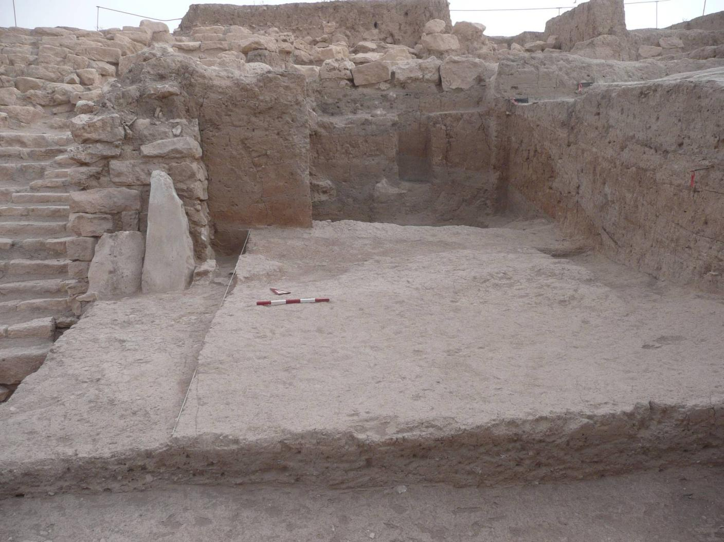
Copyright 2008 - IIMAS

Slide 38
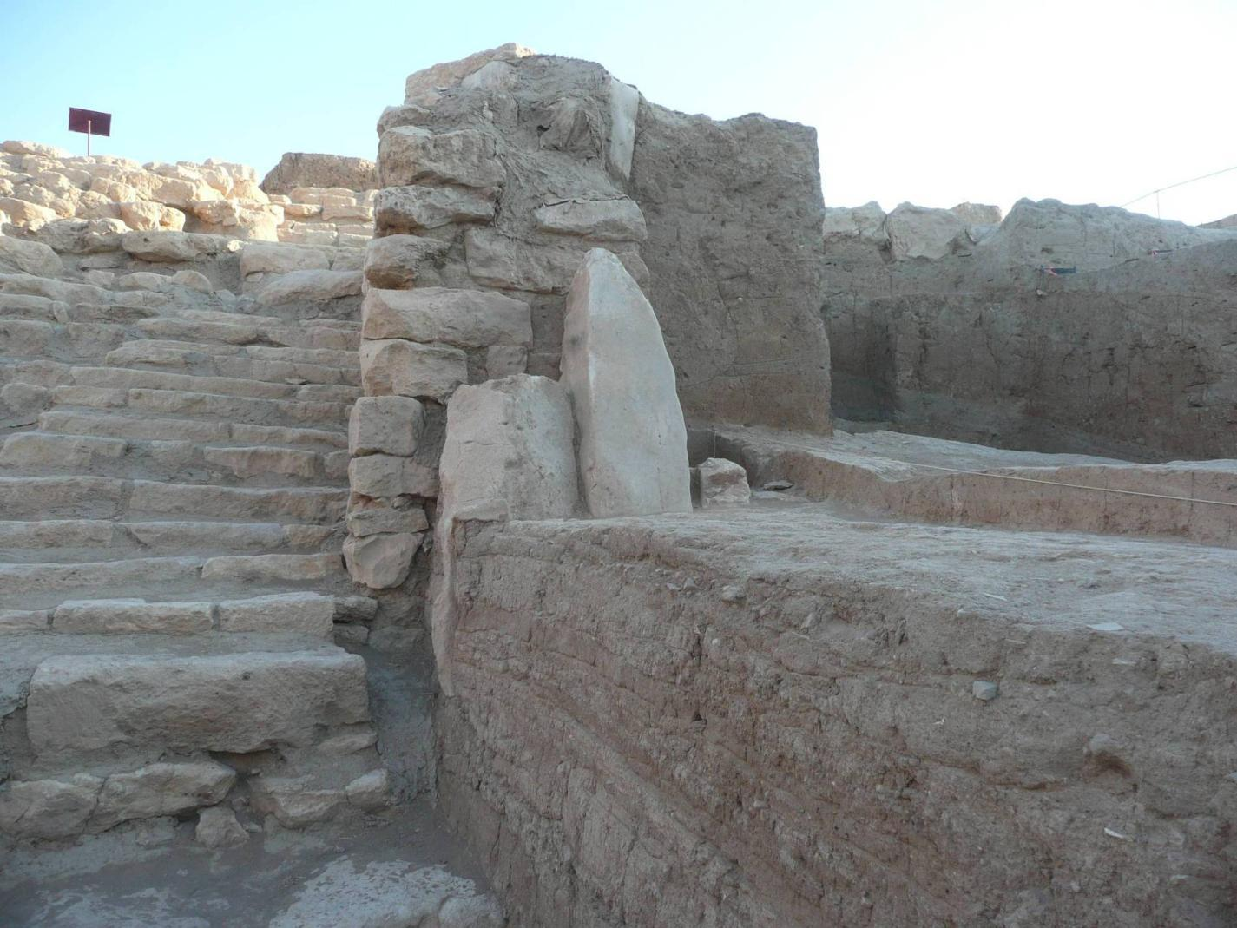
Copyright 2008 - IIMAS

Slide 39
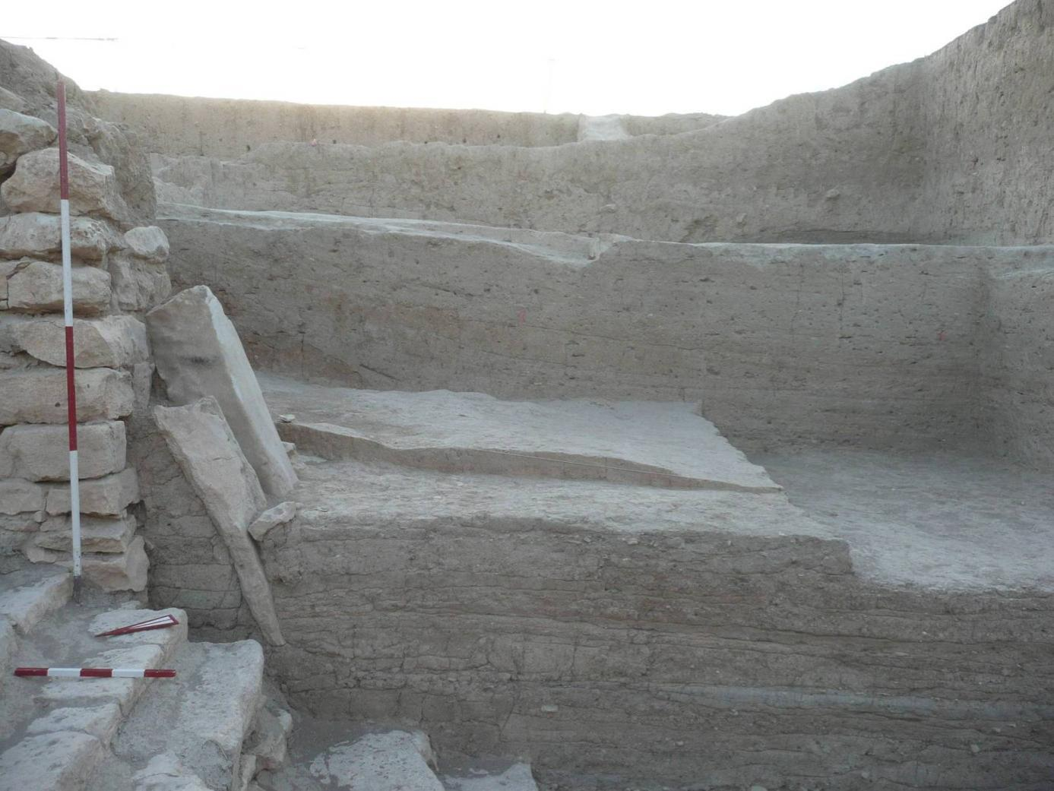
Bricks supporting the betili
Copyright 2008 - IIMAS

Slide 40
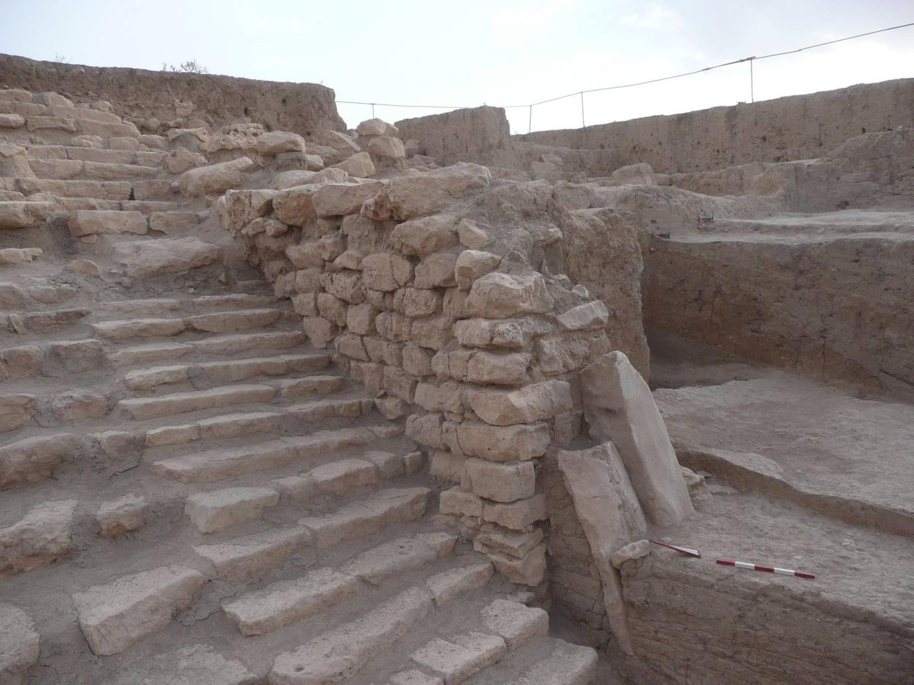
Copyright 2008 - IIMAS

Slide 41
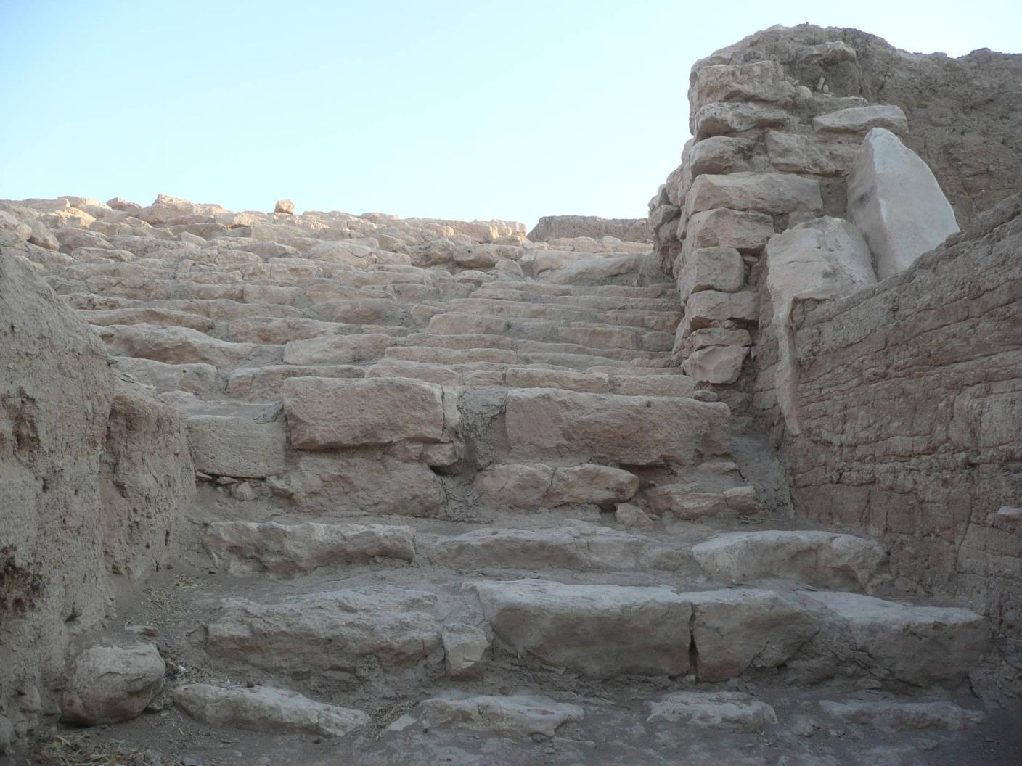

Slide 42
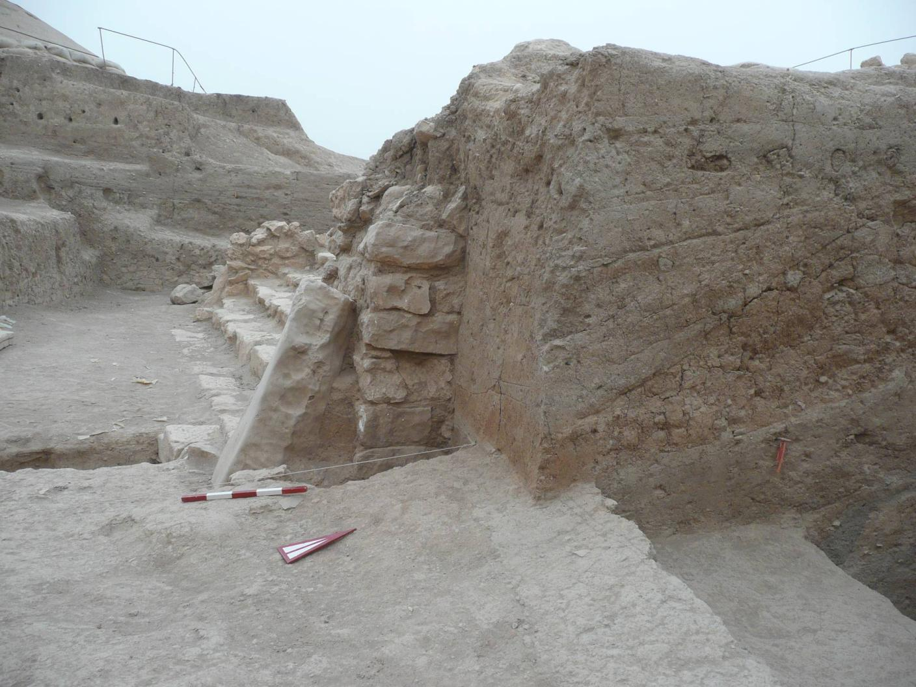
Copyright 2008 - IIMAS

Slide 43
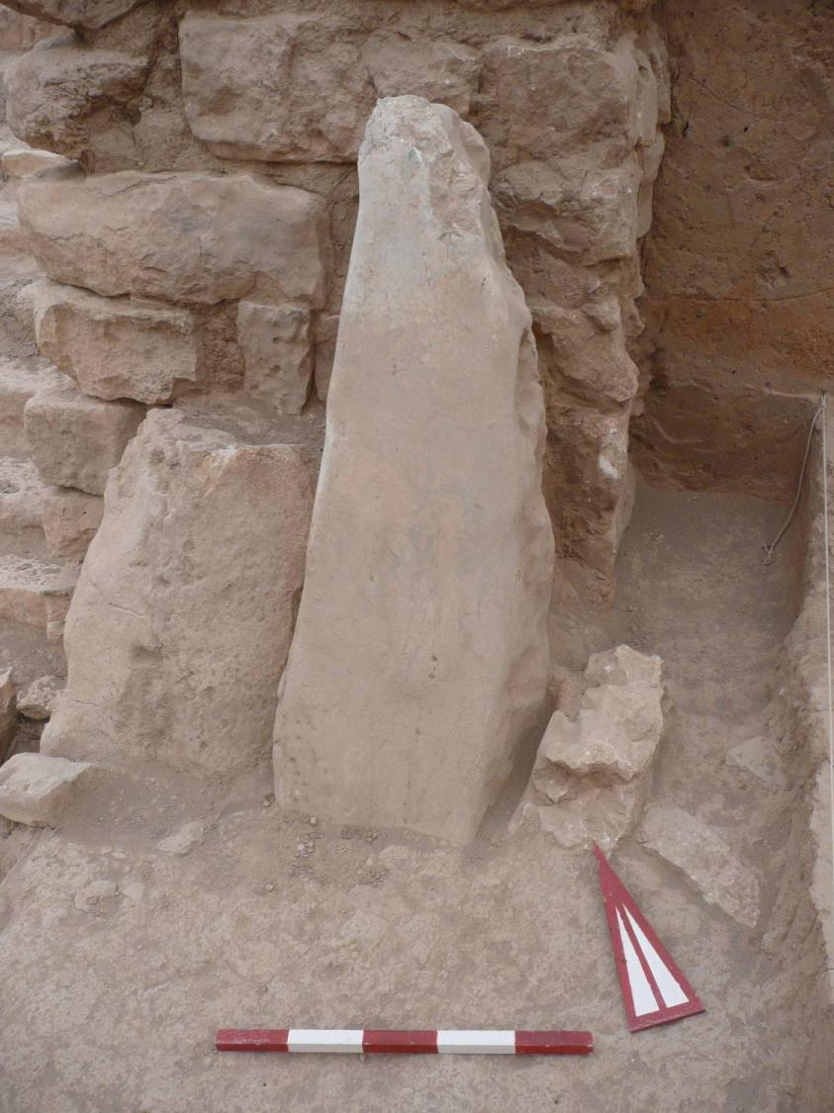
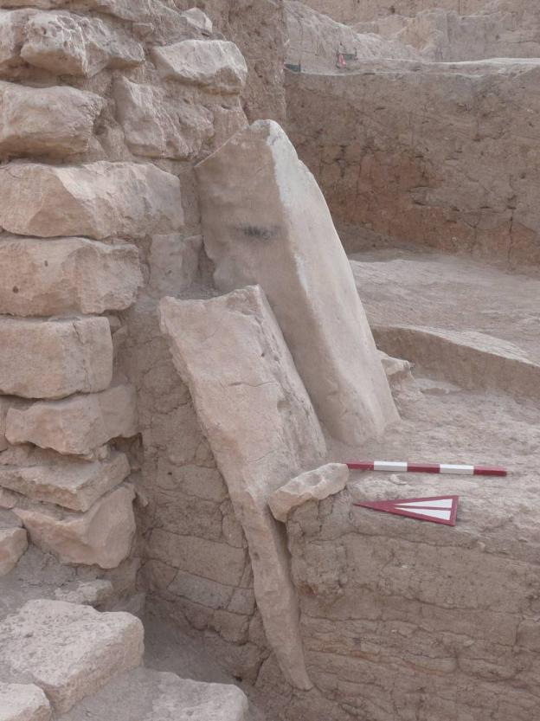
Copyright 2008 - IIMAS

Slide 44
J7
The southern end of the Plaza
The deposit overlaying the Plaza is “inert” in the sense that, from all we know so far, there were no structures – only the accumulations resulting from the water flow and the wind. As a result, excavations can proceed at a faster pace than in other operations.
In J7 we opened a large triangular swath that will eventually open a broad vista from the south-eastern corner of the Plaza looking towards the Terrace, at a vantage point where one can particularly appreciate the view of the staircase from the same elevaion as the ancients (that of the Plaza).

Slide 45
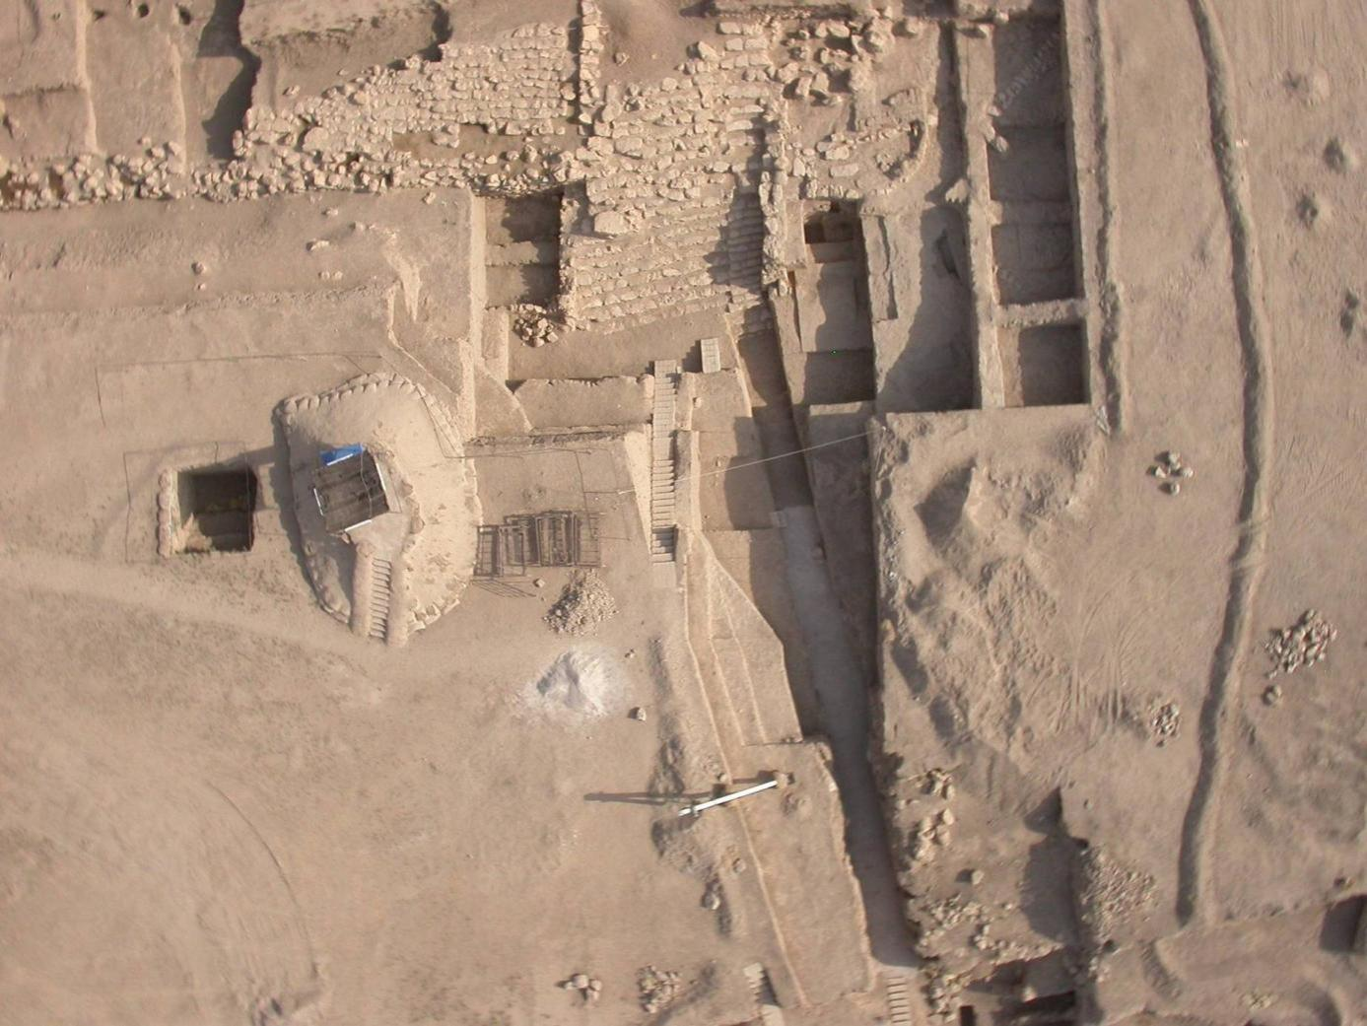
Copyright 2008 - IIMAS

Slide 46
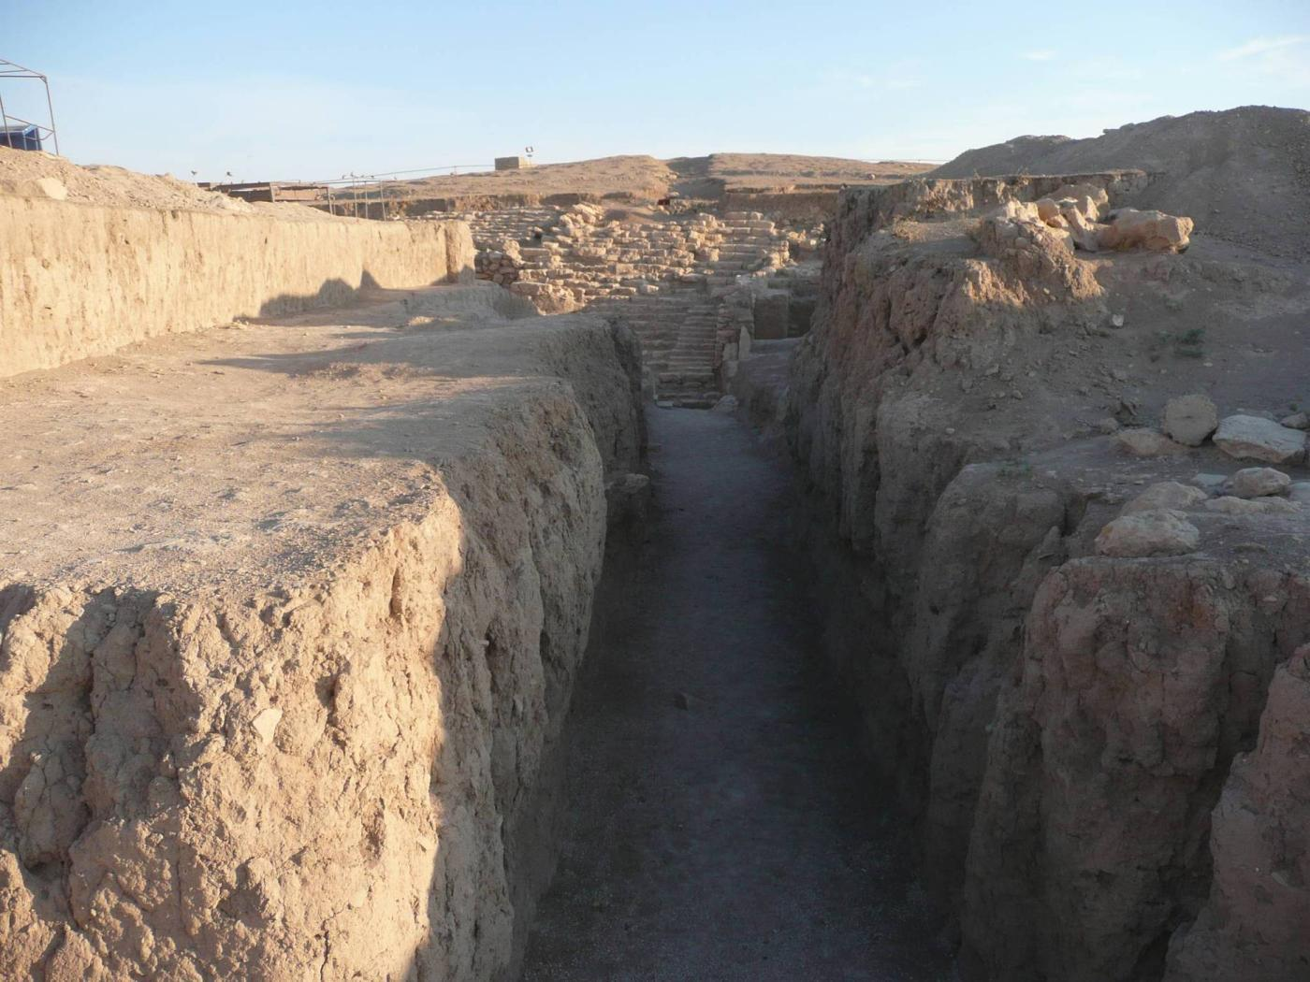
Copyright 2008 - IIMAS

Slide 47
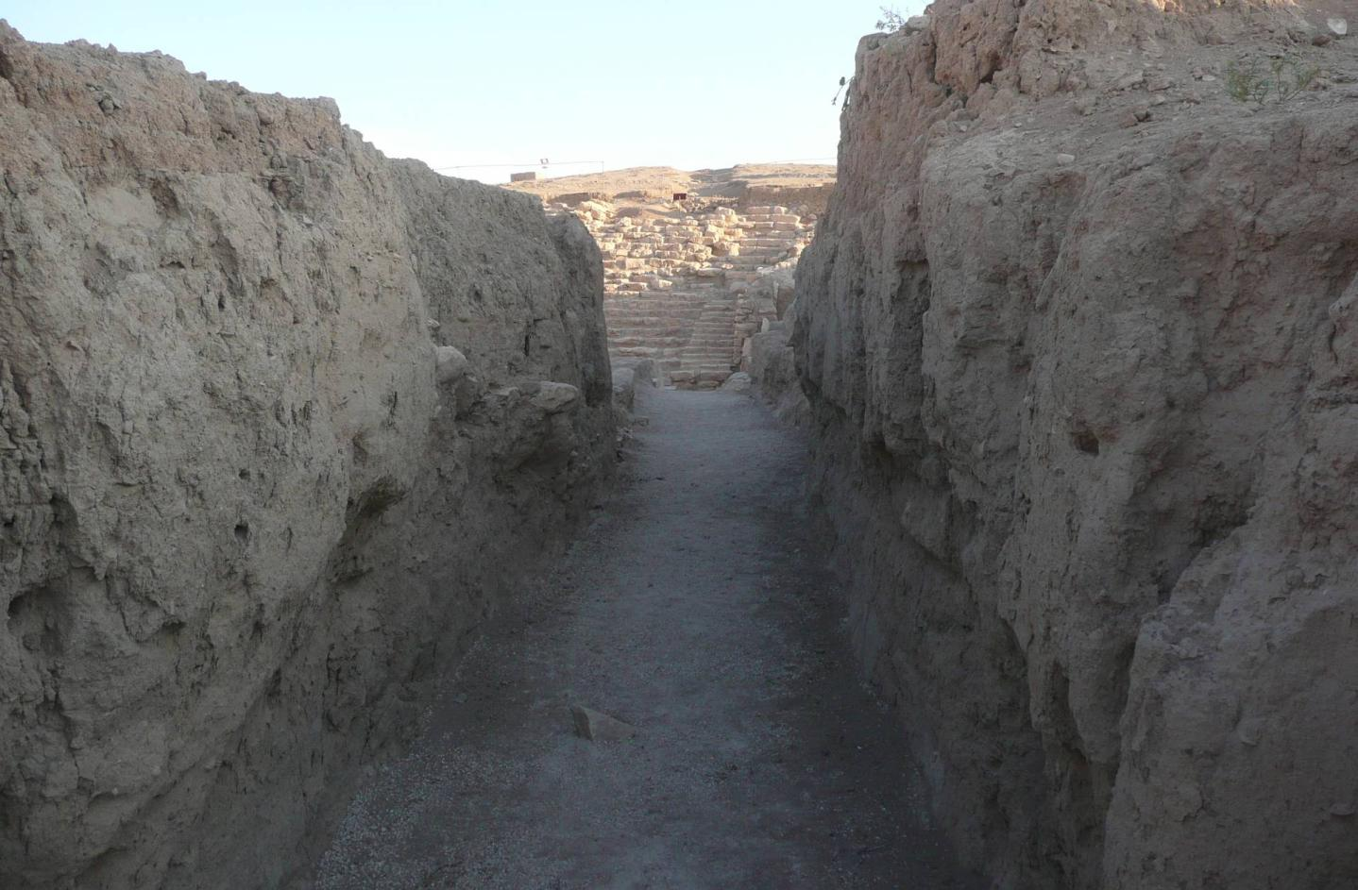
Copyright 2008 - IIMAS

Slide 48
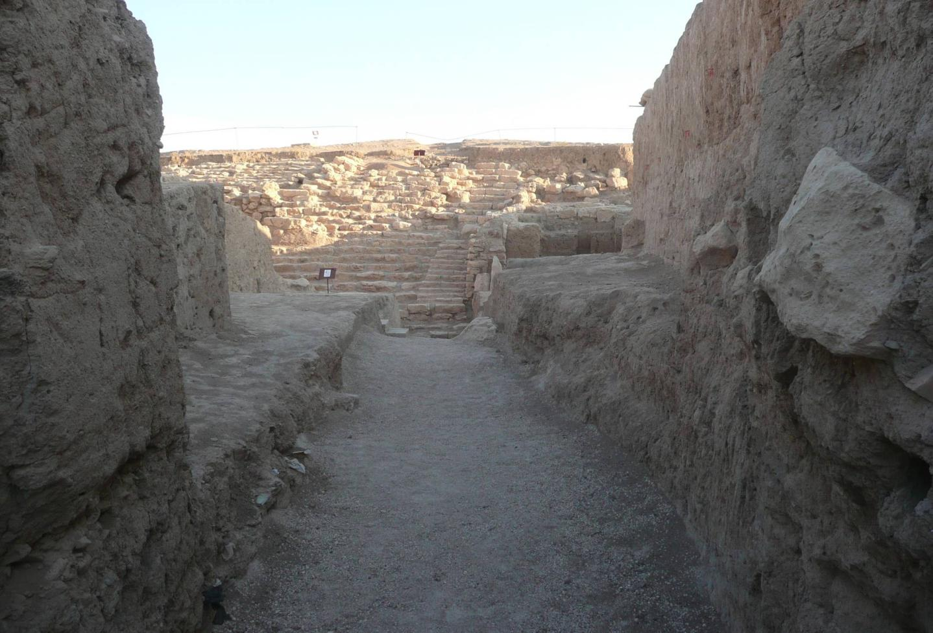
Copyright 2008 - IIMAS

Slide 49
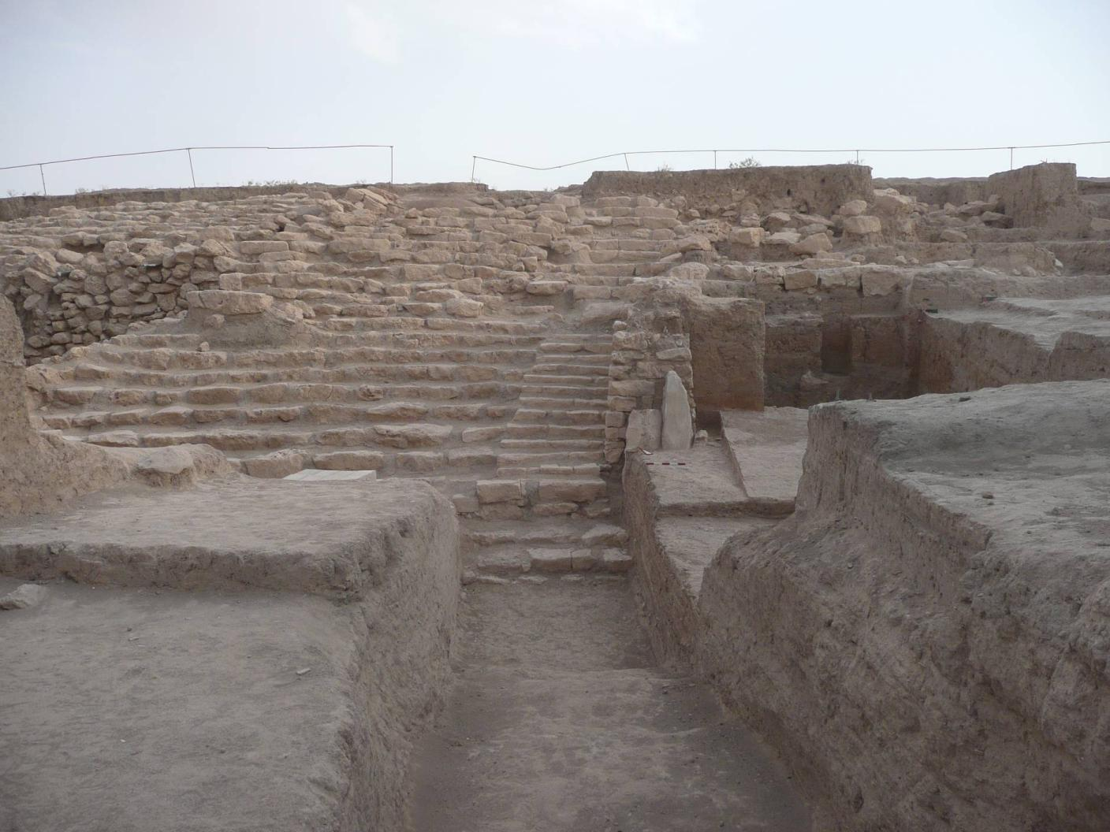
Copyright 2008 - IIMAS

Slide 50
3
The Western Service Quarter
(A20)
We resumed excavations in the area where, at a lower elevation, there is the Palace of Tupkish.
This year we opened unit A20, linking A18 and A19 excavated in earlier years.
The structures exposed suggest that this was a service area in function of the temple in the late Mittani period, at which time the Temple was accessed through the staircase exposed in J5.

Slide 51
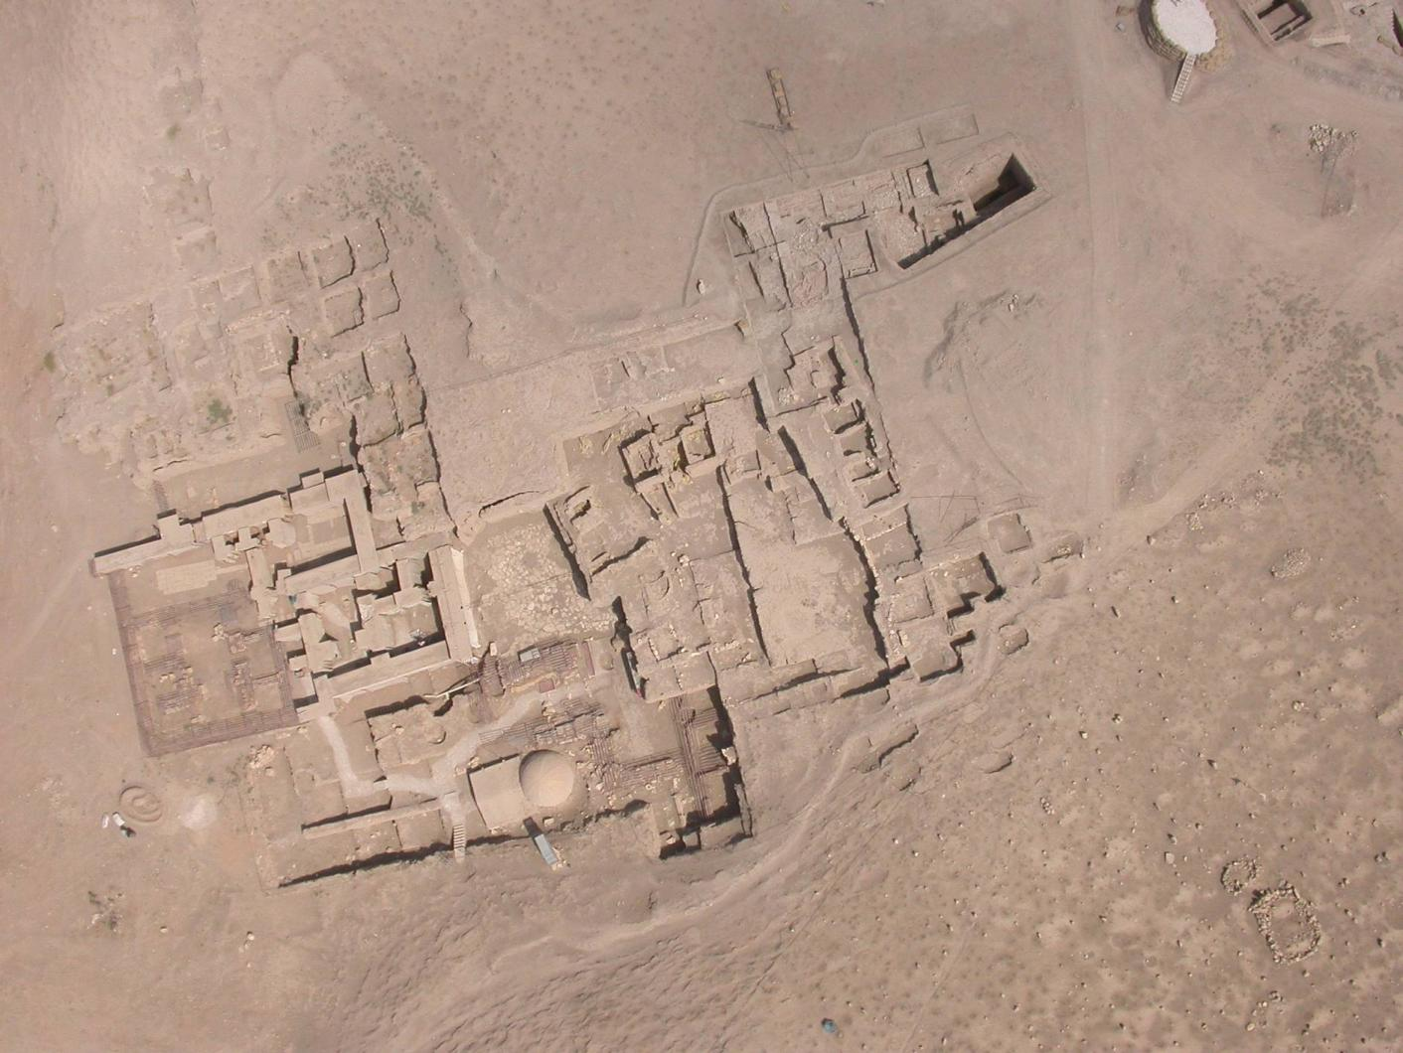
J5
A20
AA
Copyright 2008 - IIMAS

Slide 52
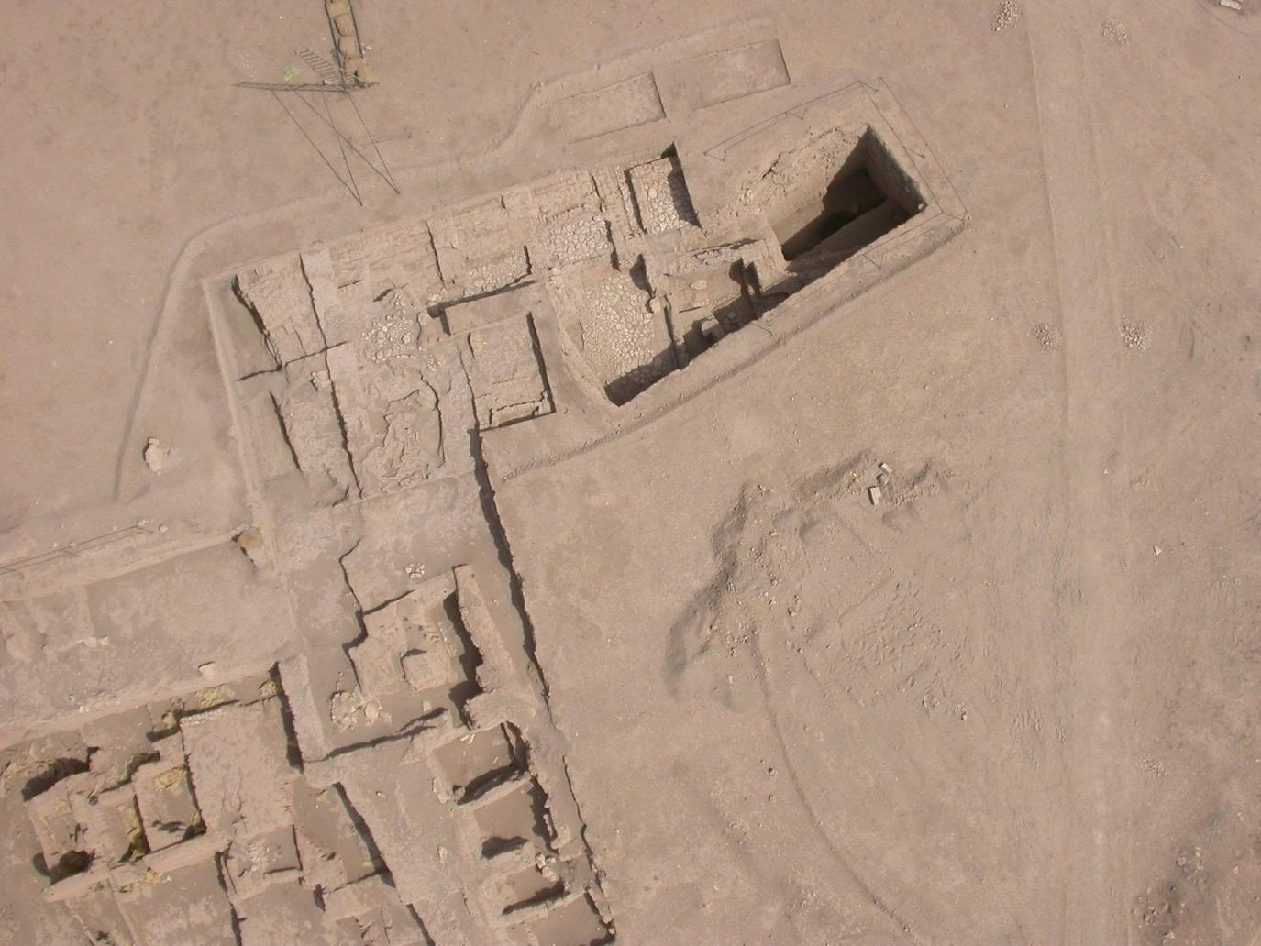
A19
A20
A18
Copyright 2008 - IIMAS

Slide 53
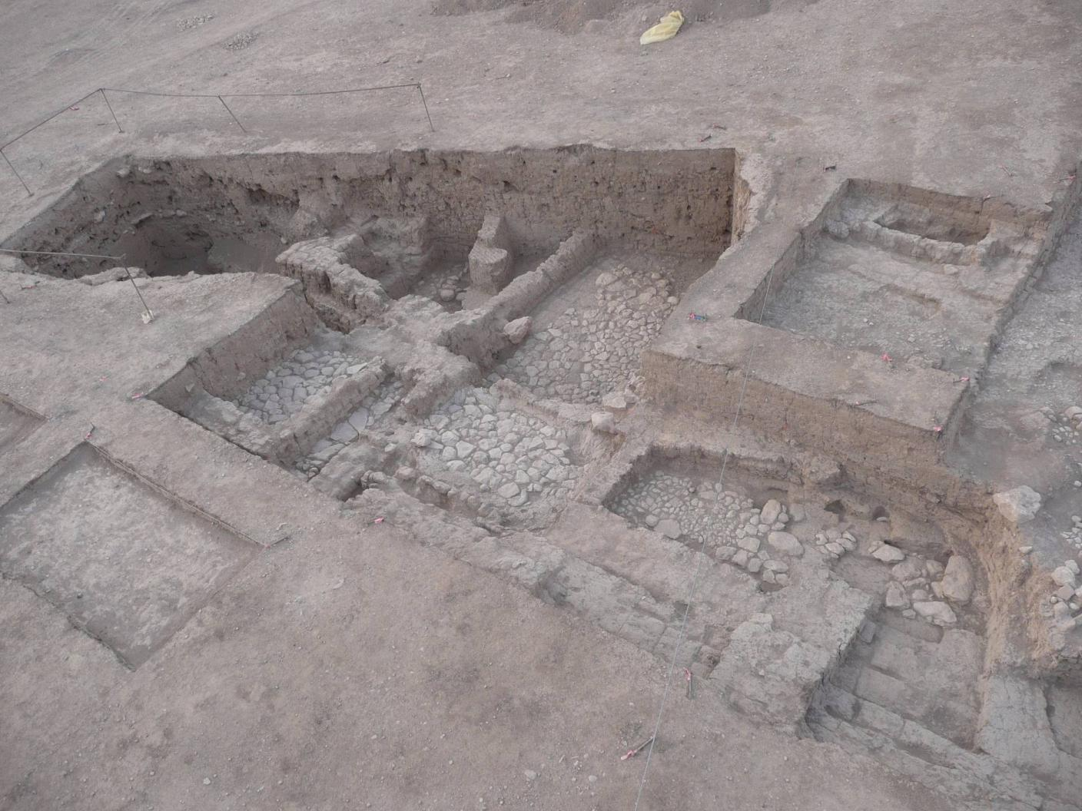
Copyright 2008 - IIMAS

Slide 54
4
The objects
Since the bulk of the excavations was in the Plaza, where we have mostly “inert” deposits, there were very few objects found this season.
Following are the more interesting ones.

Slide 55
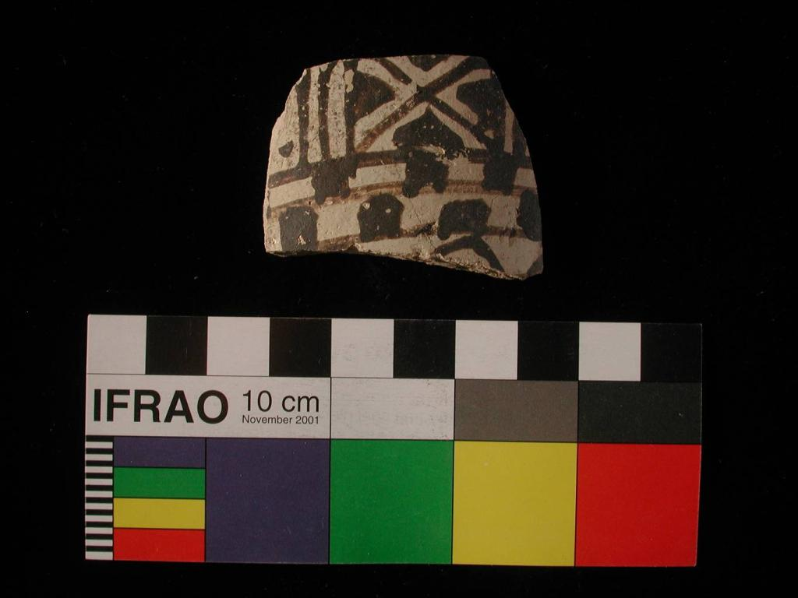
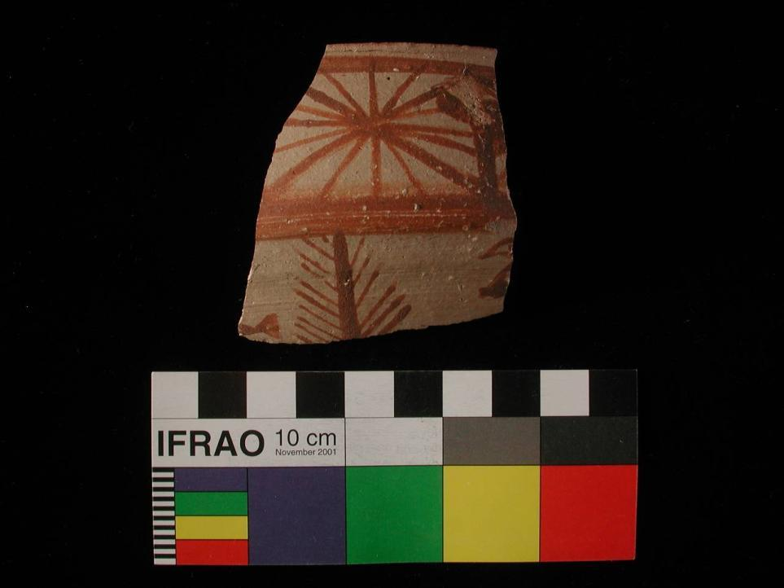
Mittani sherds (J1q1194.2 )
Copyright 2008 - IIMAS

Slide 56
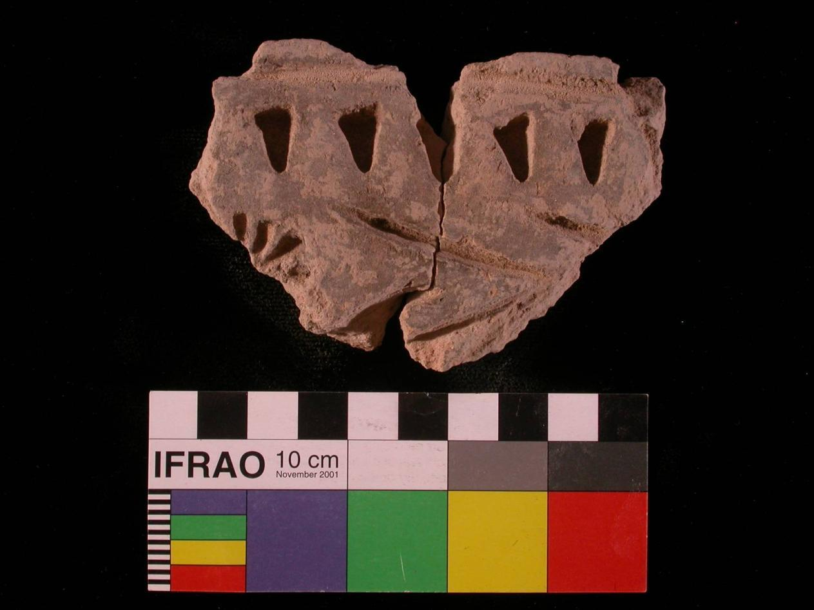
J1.54 – Plaque with decorative impressions (imitating archaic cuneiform writing?)
Copyright 2008 - IIMAS

Slide 57
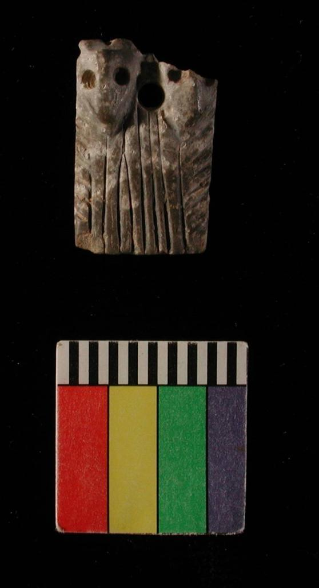
J6q218.3
Small stone pendant
Copyright 2008 - IIMAS

Slide 58
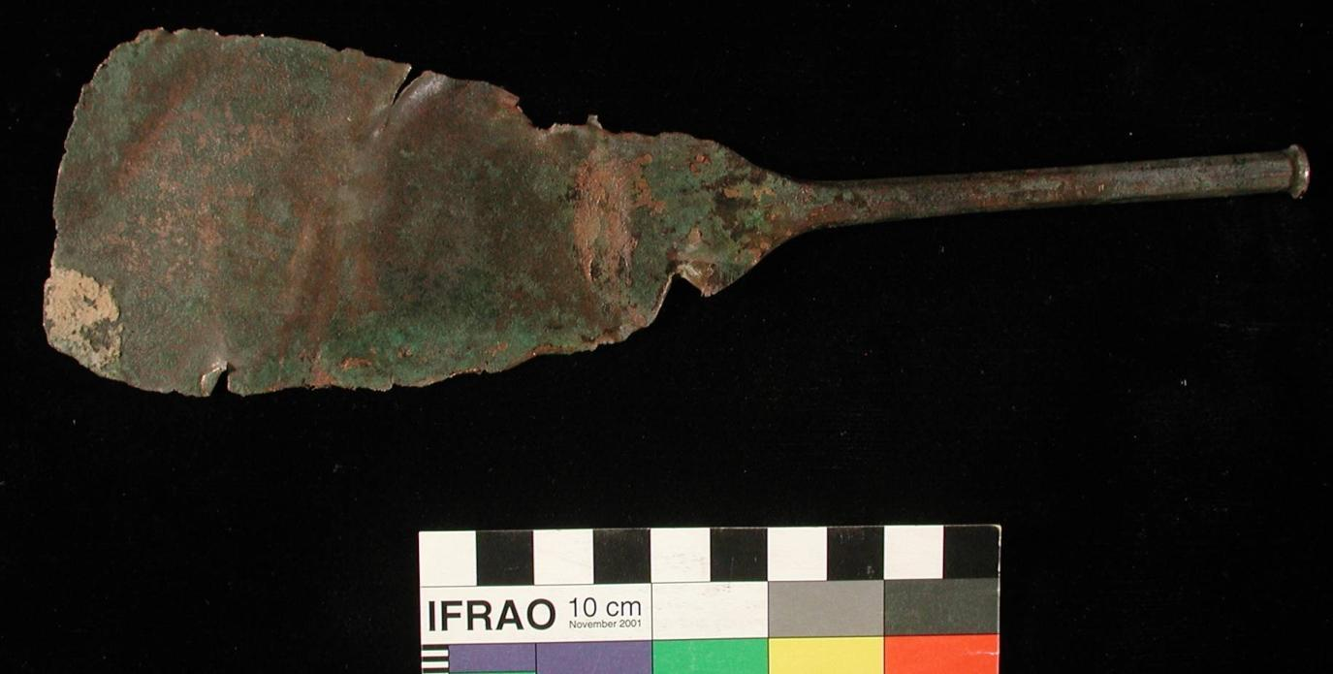
Z1.592 (surface find) – metal scaper
Copyright 2008 - IIMAS

Slide 59


J6.17
J6.18
Copyright 2008 - IIMAS

Slide 60




J5q168.1
A20.29
A9.157.1
A20.19
Copyright 2008 - IIMAS

Slide 61
5
Site Presentation
Site conservation and presentation have been a hallmark of the Mozan/Urkesh Archaeological Project ever since its inception.
In 2008 we made further great progress, especially in te area of site presentation by introducing the concept of “footnotes.”
Integrated in a vast and ambitious plan of interpretation, the site offers itself as a book to the visitor.

Slide 62
The itinerary as narrative
The itinerary is well marked, and it follows a narrative sequence that keeps the visitor interested in the progress of the presentation – with regard to both the historical development of Urkesh and the process of archaeology as a tool of discovery.

Slide 63

5
4
2
1
3
6
Copyright 2008 - IIMAS

Slide 64



Copyright 2008 - IIMAS

Slide 65
The “footnotes”
At each station along the itinerary there are small and unobtrusive panels, simple but elegant and protected against rain, sun and wind, that explain in detail what visitors see in front of them.
We call them “footnotes” because they may be read or skipped, depending on time and interest.
For those who have both (time and interest) they provide a rich commentary that anticipates and elicits all sorts of questions.
All signage is in English and in Arabic, and it is thoughtfully written, in a style that aims at captivating the casual visitors and to provide needed information to the even the scholar.
The footnotes were all written and set up during the 2008 season.

Slide 66

Copyright 2008 - IIMAS

Slide 67


Copyright 2008 - IIMAS

Slide 68

Copyright 2008 - IIMAS

Slide 69

Copyright 2008 - IIMAS

Slide 70

Copyright 2008 - IIMAS

Slide 71

Copyright 2008 - IIMAS

Slide 72
The synthetic panels
While the footnotes are in the immediate proximity of the views which they describe, the synthetic panels are set up on high vista points from which one can gain an overall views of large sectors of the excavations.
These panels (started in earlier season and continued in 2008) provide general overviews on a variety of topics.
Between synthetic panels and “footnotes” we already have in place some 200 pages of what is, in effect, a living book.

Slide 73

Copyright 2008 - IIMAS

Slide 74

Copyright 2008 - IIMAS

Slide 75

Copyright 2008 - IIMAS

Slide 76
Copyright 2008 - IIMAS

Slide 77
The eco-archaeological park
In 2008 we have developed further the idea of creating an eco-archaeological park that would protect the environment of the site, for a radius of some 6 kilometers around it.
We are in the process of developing proposals that will define in greater detail the scope of the project.

Slide 78

Copyright 2008 - IIMAS

Slide 79

9.5 km
11 km
Copyright 2008 - IIMAS

Slide 80
The visitors
In 2008 we expanded the live presentation program addressed to our local “stakeholders.”
Besides weekly lectures

Slide 81


Copyright 2008 - IIMAS

Slide 82

Copyright 2008 - IIMAS

Slide 83

Copyright 2008 - IIMAS

Slide 84

Copyright 2008 - IIMAS

Slide 85

Copyright 2008 - IIMAS

Slide 86
6
The visit of the First Lady
The great honor the First Lady paid us by visiting Mozan one early morning in August, coming from Damascus just to see our site, gave us the great pleasure of benefiting from her insightful comments on our work.
It was a great test of our effort at site presentation…

Slide 87


Slide 88


Slide 89


Slide 90


Slide 91


Slide 92


Slide 93
tra il 1984 e il 2008
il progetto Mozan/Urkesh è stato sovvenzionato da
The Ahmanson Foundation
The Ambassador International Cultural Foundation
The American Cultural Center, Damascus
The Catholic Biblical Association
The Cotsen Institute of Archaeology, UCLA
The Council of Research, Academic Senate, UCLA
The Getty Conservation Institute
IIMAS – The International Institute for Mesopotamian Area Studies
The Mellon Foundation
The Metropolitan Museum of Art
The National Geographic Society
The National Endowment for the Humanities
The Neutrogena Corporation
The Samuel H. Kress Foundation
The San Carlos Foundation
The L. J. Skaggs and Mary C. Skaggs Foundation
The Steinmetz Family Foundation
Syria Shell Petroleum Development, B.V.
The Urkesh Founders

